Slide 2
Who is Vladimir Ribakov?
Full Time Trader
Personal Forex Mentor
Owner of the online forex club “Vladimir Forex Signals”
Formal Hedge Fund Trader
Consultant for hedge Fund Houses and Banks
www.VladimirRibakov.com

Slide 3
Today I will talk about:
THE ART OF CYCLES

Slide 4
I have broken down the subject into the following:
Introduction to Fibonacci
Cycles in the markets
Types of Cycles
Statistics in Cycle Trading
How Cycles provide Risk:Reward trades of 1:20 and more
Mirror Principle that “smart money” is hidding from you
Special Gift – Cycle’s Statistical Indicator

Slide 5
We are going to dig very deep today in Cycles. But first, let’s meet a tool that will be very helpful for us.

Slide 6
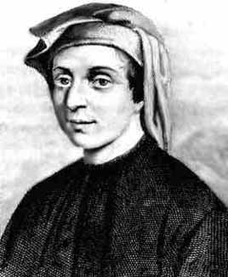
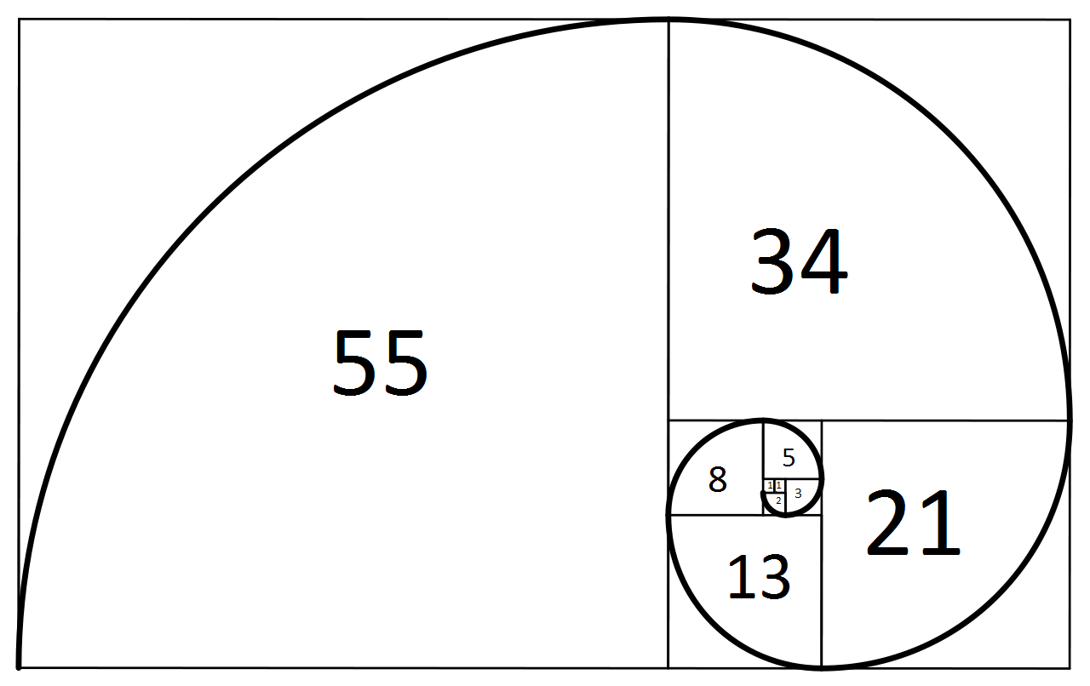
Introduction To Fibonacci
Leonardo Bonacci - known as Fibonacci, Leonardo of Pisa, was an Italian mathematician, considered to be "the most talented Western mathematician of the Middle Ages".
Fibonacci popularized the Hindu–Arabic numeral system to the Western World primarily through his composition in 1202 of Liber Abaci (Book of Calculation). He also introduced Europe to the sequence of Fibonacci numbers, which he used as an example in Liber Abaci.
In mathematics, the Fibonacci numbers are the numbers in the following integer sequence, called the Fibonacci sequence, and characterized by the fact that every number after the first two is the sum of the two preceding ones:
1, 1, 2, 3, 5, 8, 13, 21, 34, 55, 89, 144

Slide 7
Introduction To Fibonacci
I will not go any deeper in the theoritical part of how fibonacci sequence works. If you are interested you may find plenty of materials on the internet.
We are interested in the essentials of the fibonacci sequence and how they fit into the trading world. As you probably know the golden ratio could be found anywhere in the nature. Markets are not an exception.
The Fibonacci numbers that traders use on their charts work for one reason or another. There are a lot of debates WHY exactly price reacts to these levels but it is more imporatnt that it DOES.
The Fibonacci levels are sort of self-fulfilling prophecies. What that means is that the more people use them, the more powerful these levels become.

Slide 9
IMPORTANT:
Behind the scenes of the trading world, magic happens. Big money option are written and expired according to these very same Fibonacci levels. Remember – Fibo is not just in trading but in any aspect of life numbers related.
This information is priceless to us – the retail traders.
By the end of this lesson you will find out WHY.

Slide 10
We are interested in two fibonacci tools that come built-in most trading platforms out there:
Fibonacci Retracement
Fibonacci Expansion

Slide 11
How are the Fibonacci Retracement & Expansion Levels Derived From The Fibonacci Sequence?
61.8% = divide current number with next (from 13 onward)
e.g. 55/89 = 0.618 (approx.)
161.8% = divide next number with current e.g. 89/55 = 1.618.
This is also called the “golden ratio”
38.2% = 0.6182 (or skip 1 sequence in division e.g. 55/144 = 0.382)
23.6% = skip 3 sequences in division e.g. 34/144 = 0.236 (approx.)
78.6% = √0.618
127.2% = √1.618
261.8% = 1.6182 or 1.618
0%, 50%, 100% & 200% are not Fibonacci numbers, but are nonetheless used by some traders as they are psychological levels (round numbers)

Slide 12
Some Important Fibonacci Levels
As seen above there are many fibonacci numbers however traders use and rely on some levels more than the others. Some of the most commonly used levels are:
161.8% 50%
100% 38.2%
61.8% 23.6%

Slide 13
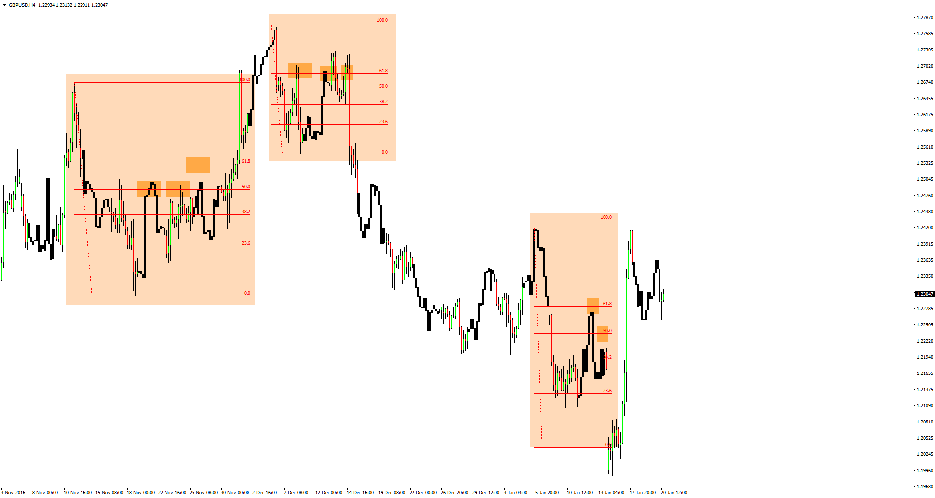
A perfect example of how the “main” (if we can call them that) numbers are well respected
Fibonacci Retracement

Slide 14
Fibonacci Retracement & Expansion
The Fibonacci retracement tool as the name suggests is used when the price is correcting itself during a trend. The correct way to place the fibonacci retracement is to find a top or bottom (swing) and let the price run.
Once you see an opposite move, this is where the second point is set. Let’s have a look at an example:

Slide 16
Fibonacci Retracement & Expansion
In summary:
The fibonacci retracement is used to forecast levels to which the price is very likely to correct itself during a trend. Usually used as Entry levels.

Slide 17
Fibonacci Retracement & Expansion
Fibonacci Extension on the other hand is used to predict or forecast what levels the price might reach in the direction of the trend.
The projection is a perfect way to set your targets. It uses 3 reference points on the chart as opposed to the retracement tool. Example:

Slide 18
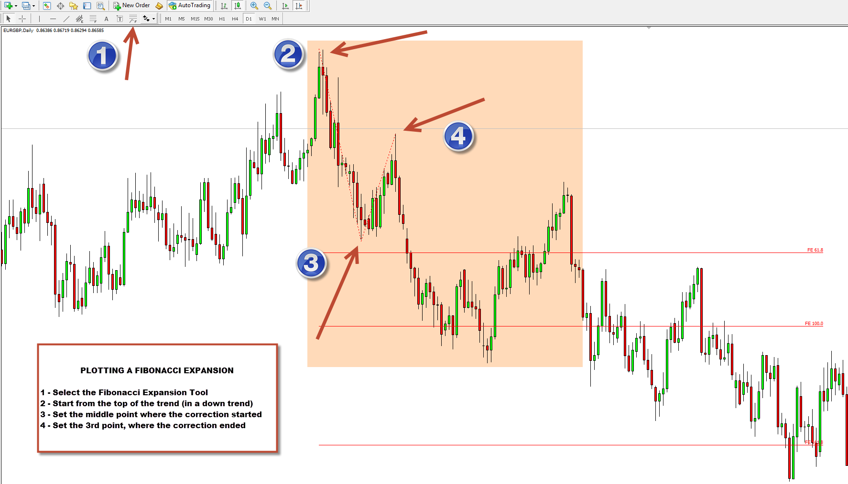
Fibonacci Retracement & Expansion

Slide 19
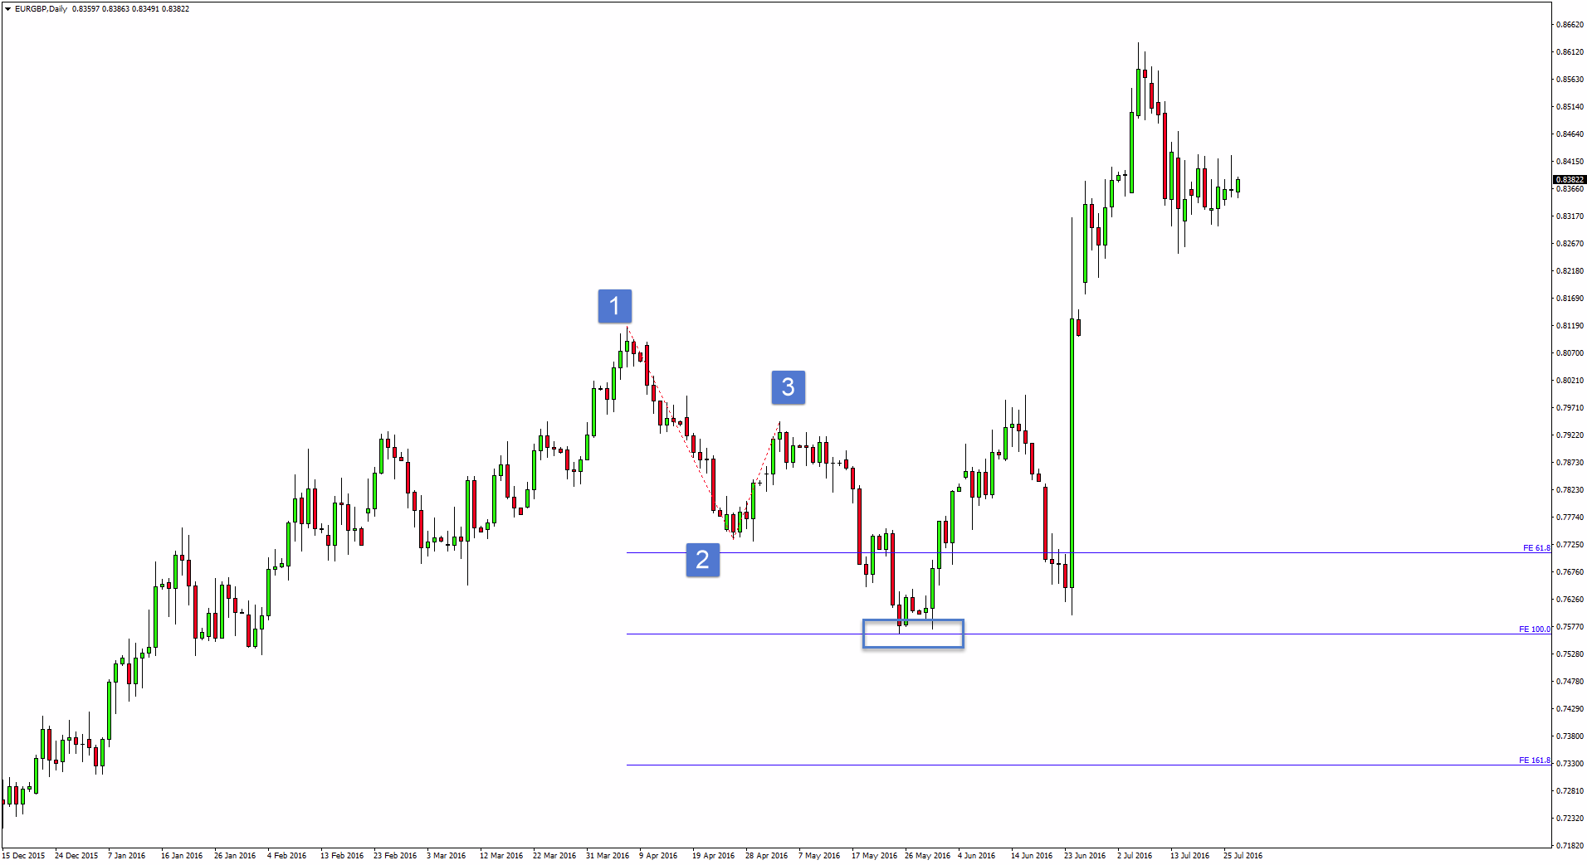

Slide 20
Now that you have an idea what Fibonacci Retracement and Expansion is we can move on!

Slide 21
CYCLES IN THE MARKETS

Slide 22
What Are Cycles?
Cycles are NOT a trading strategy.
Cycles show where the BIG money is and where it goes.
Cycles simply give you the direction in which you should trade.
Any trading strategy could be applied along with the cycles.
Cycles are more powerful on the higher time frames.
Cycles allow us to catch amazing R:R Ratio trades.

Slide 23
Why Do Cycles Appear ?
Cycles could be called in many names.
Cycles are created with the BIG money. Cycles ends when BIG money options expire and Cycles are created when BIG money writes an option or plan.
When there is a Cycle on the chart, chances are “smart money” is involved.

Slide 24
Types Of Cycles
There are 3 main types of cycles + Range Cycles:
Double
Triple
Special
Range

Slide 25
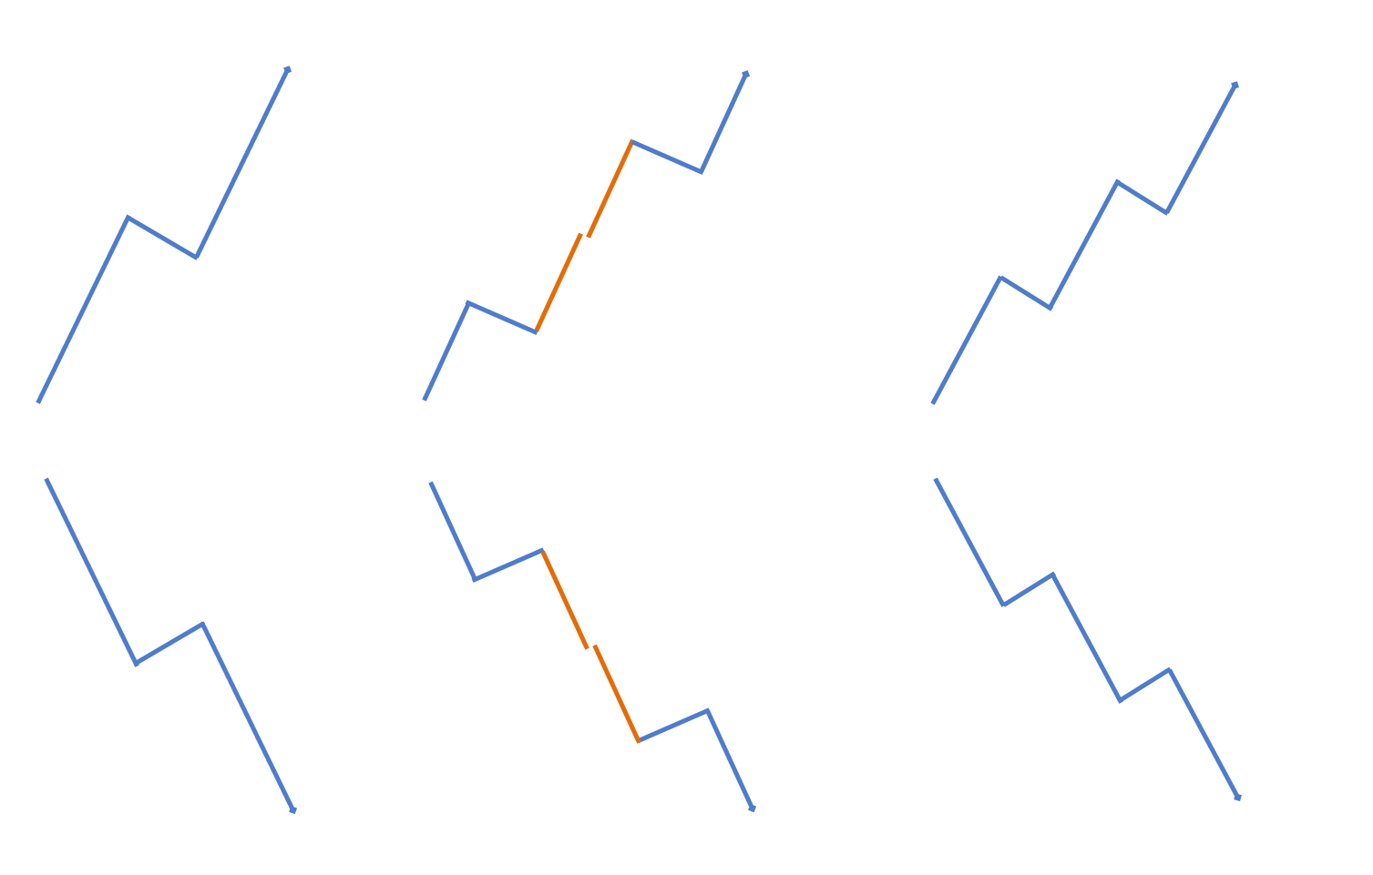
Double Special Triple

Slide 26
Double Cycle
Ideally it consists of 2 equal waves.
The 2 waves could vary in shape and duration.

Slide 27
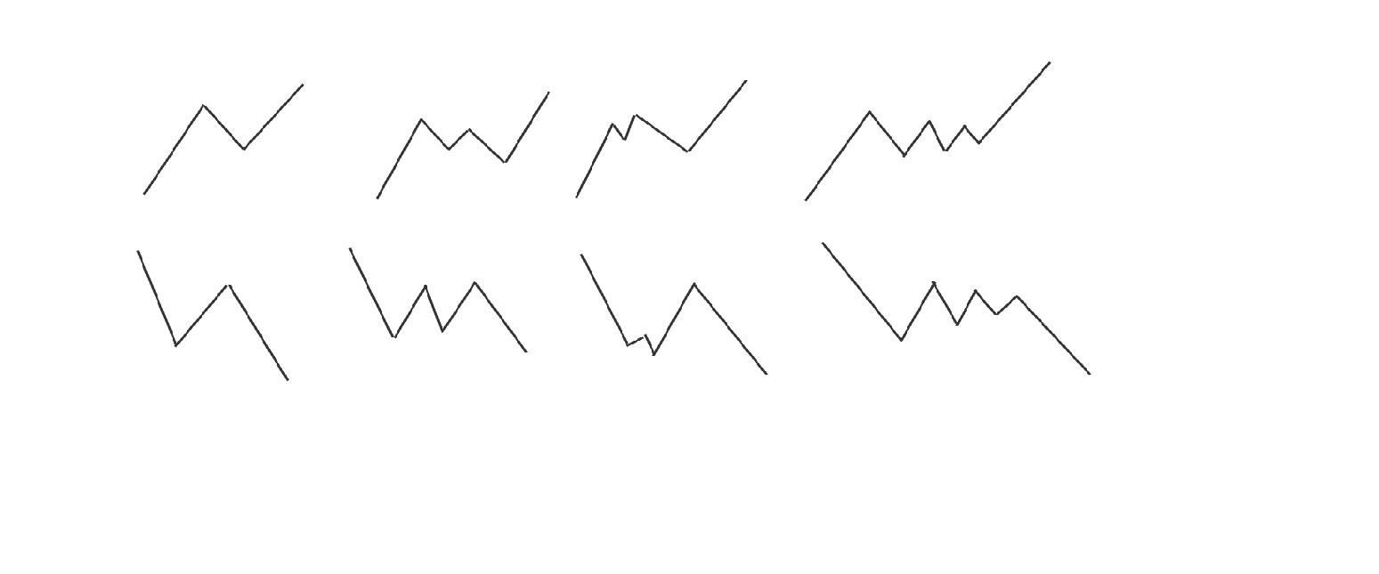
Double Cycle Variations

Slide 28
Now let’s check out a few examples

Slide 32
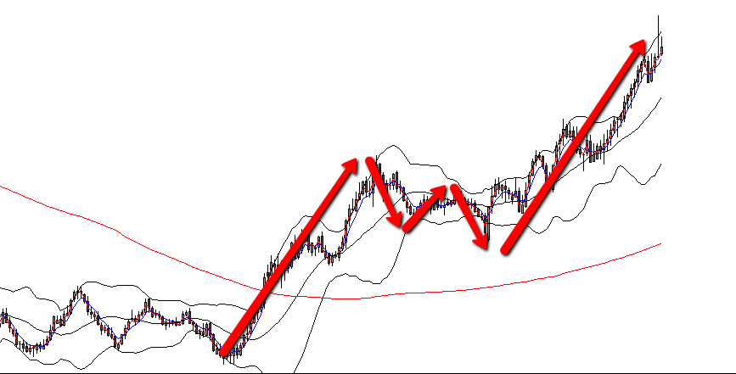

Slide 33
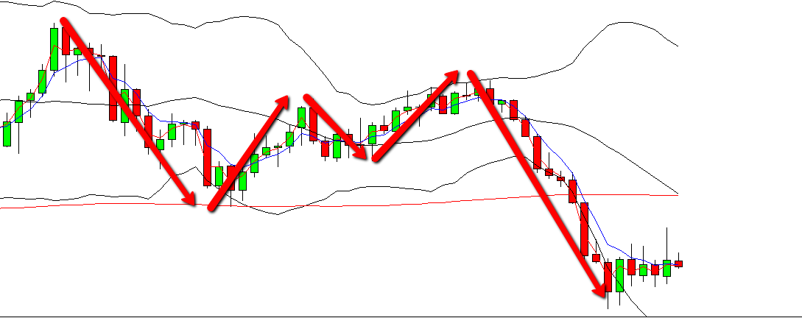

Slide 34
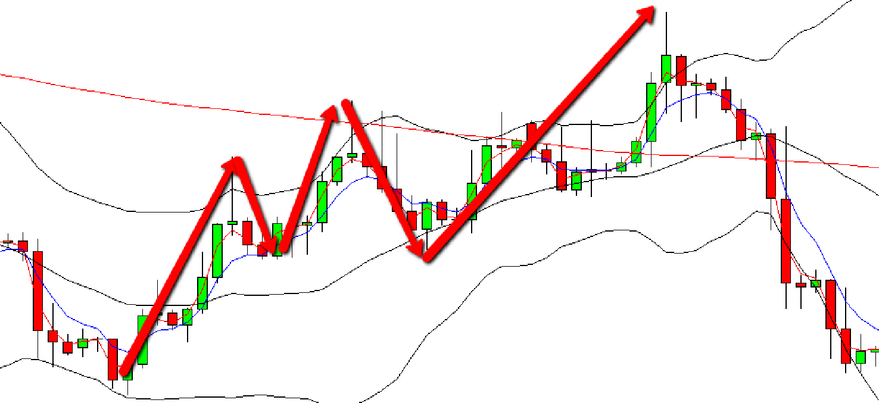

Slide 35
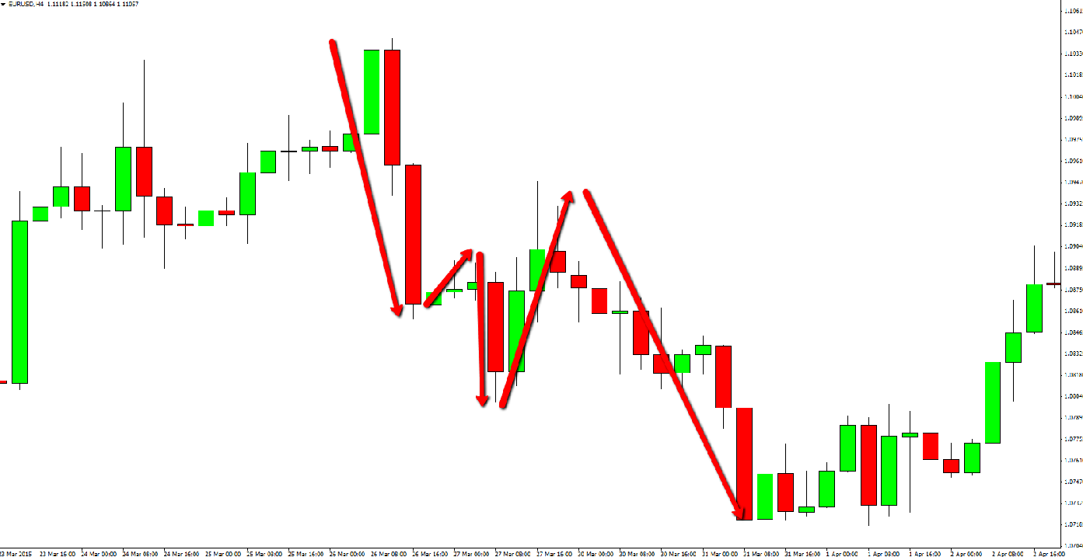

Slide 36
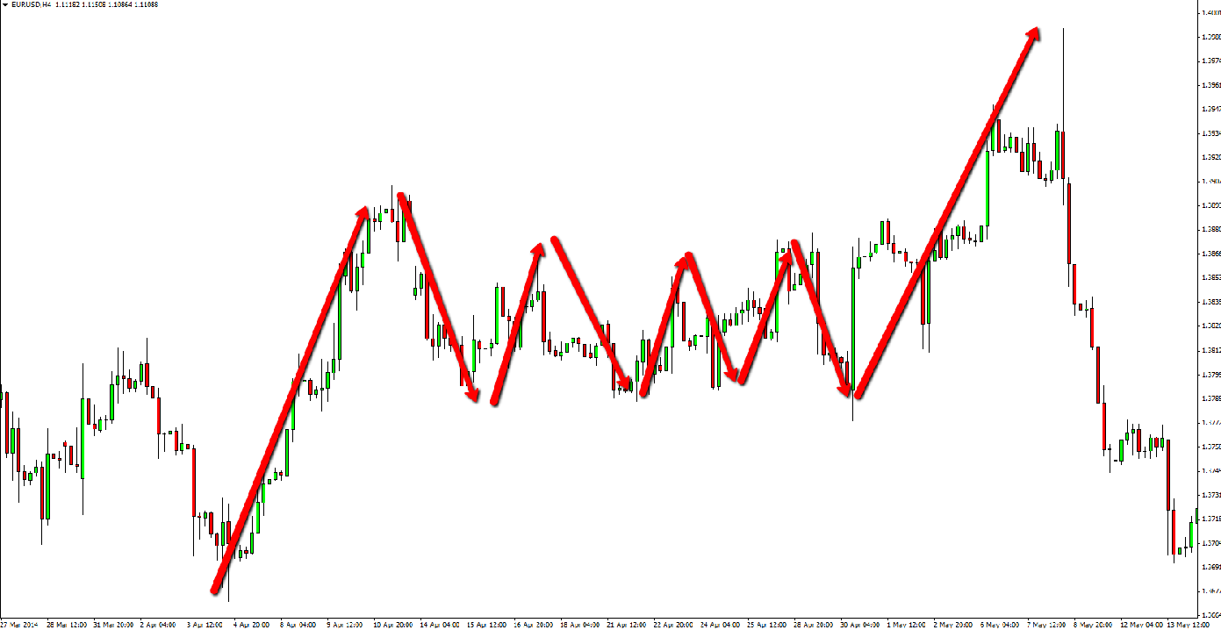

Slide 37
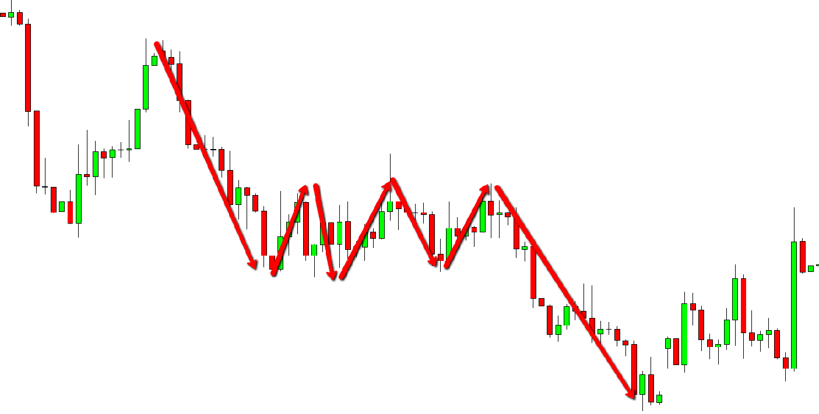

Slide 38
Triple Cycle
Consists of 3 fairly equal waves.
It is also known as 6 spot tunnel.

Slide 39
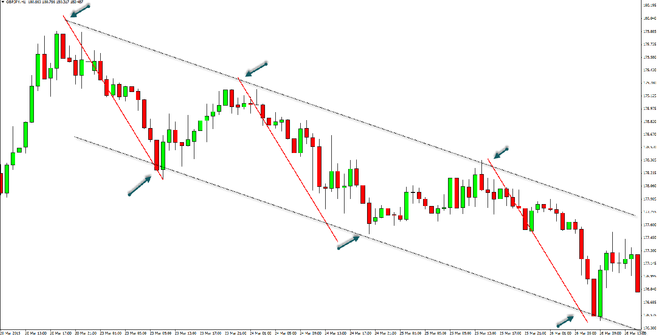

Slide 40
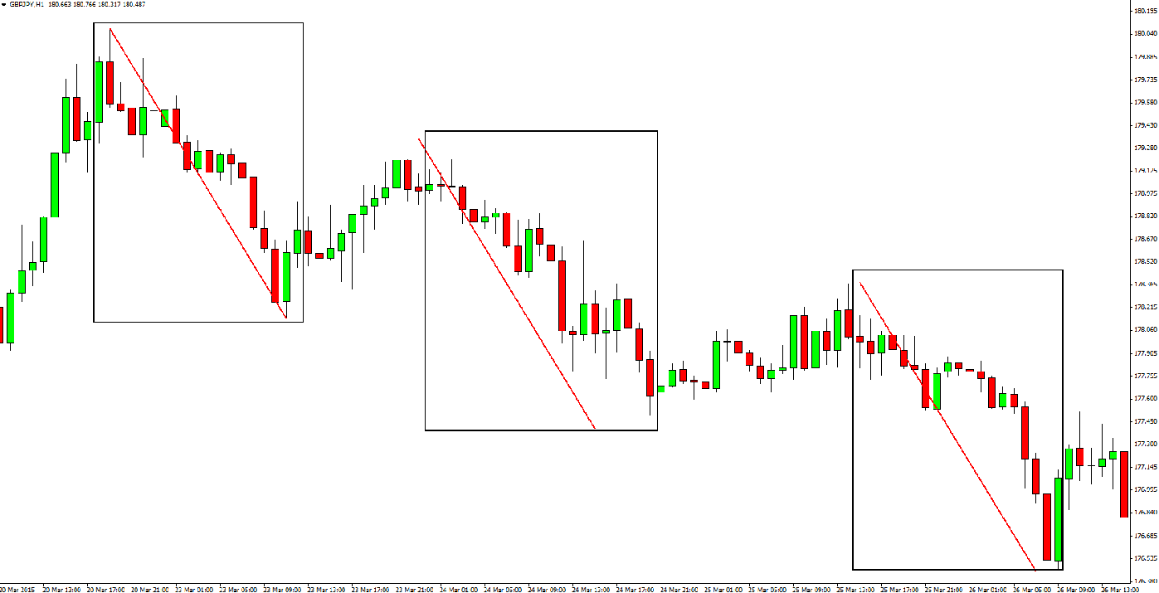

Slide 41
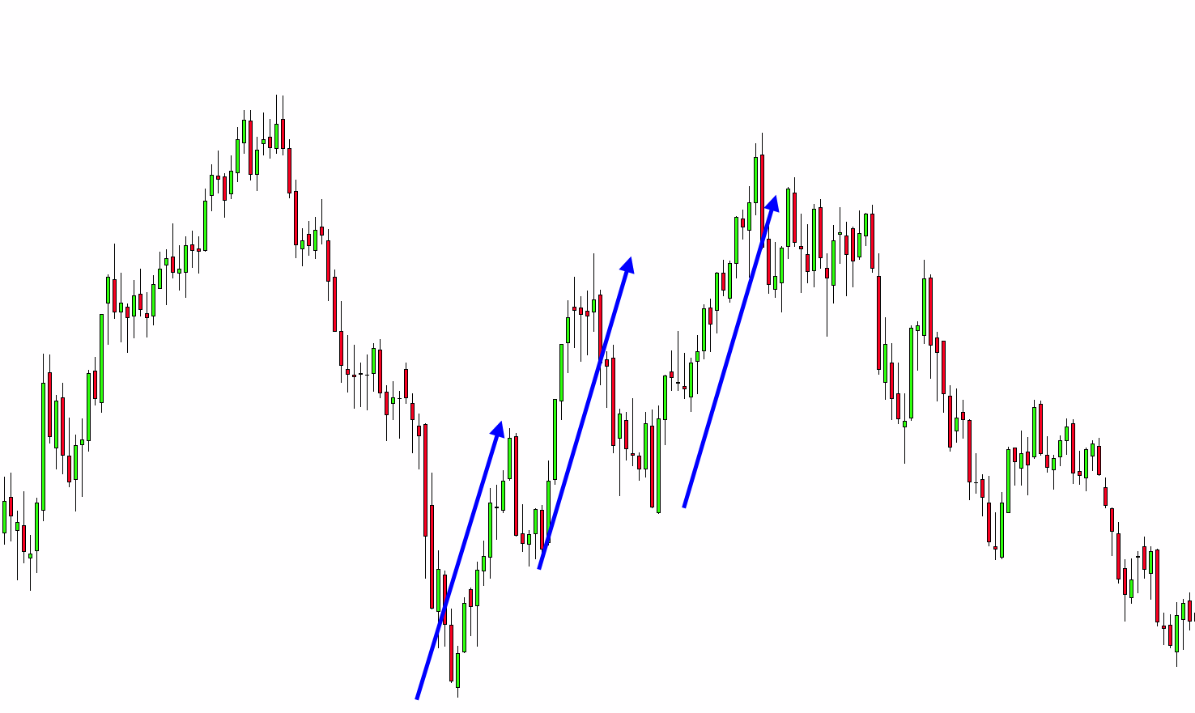

Slide 42
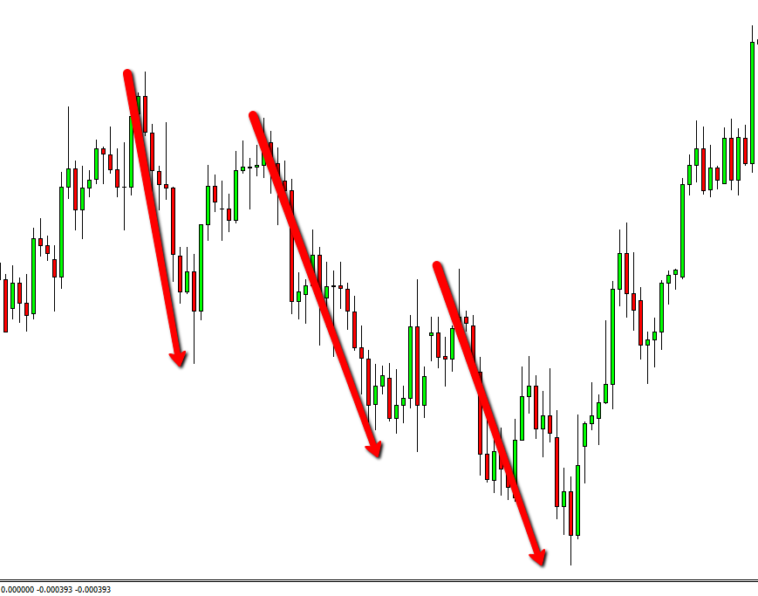

Slide 43
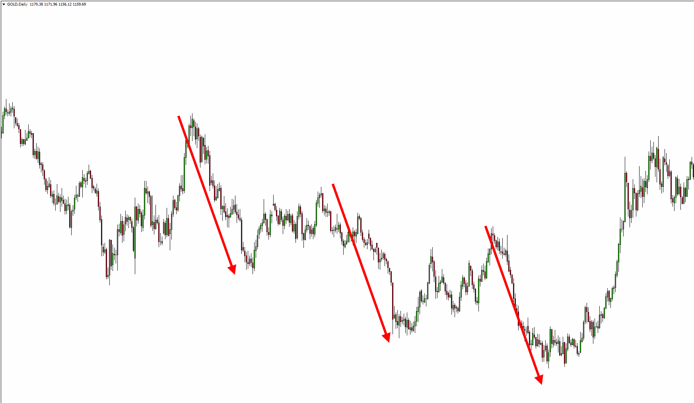

Slide 44
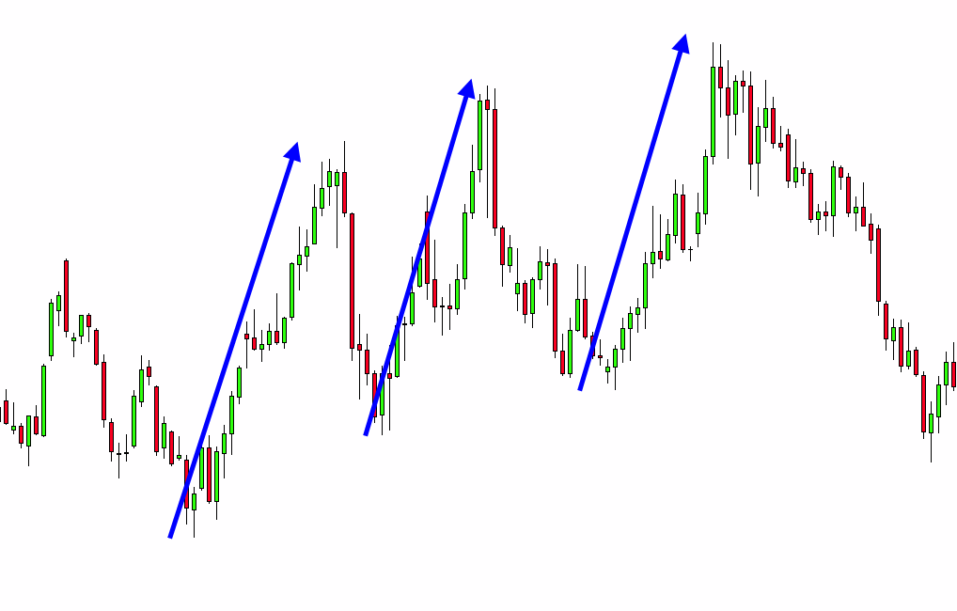

Slide 45
Special Cycle
Consists of 3 waves.
Two smaller equal waves and one larger,
expanded wave in between.

Slide 46
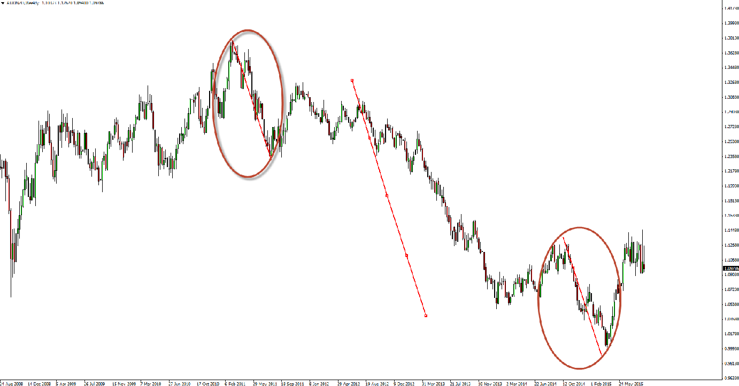

Slide 47
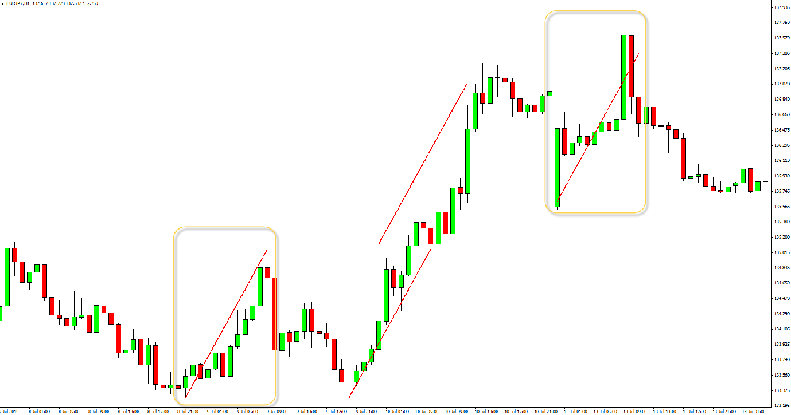

Slide 48
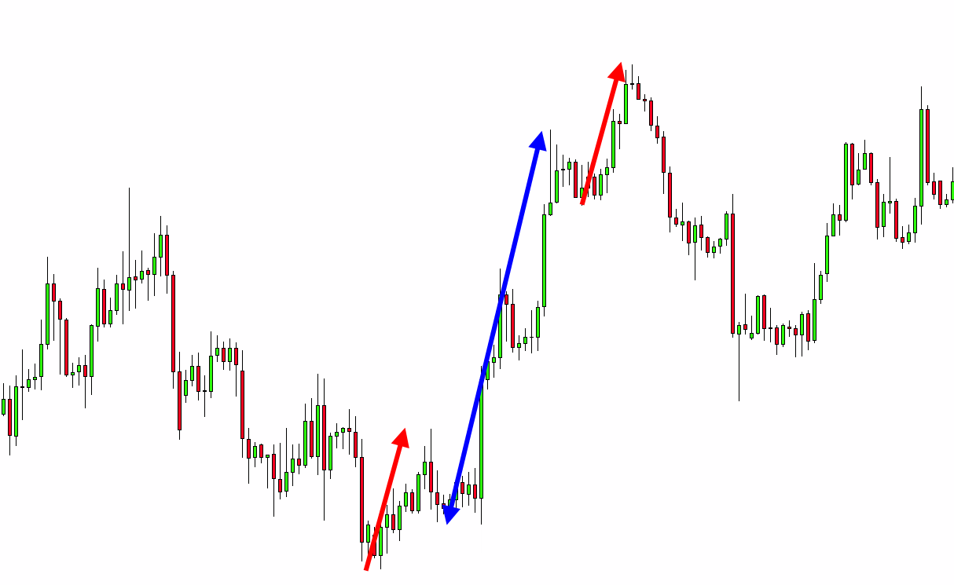

Slide 49
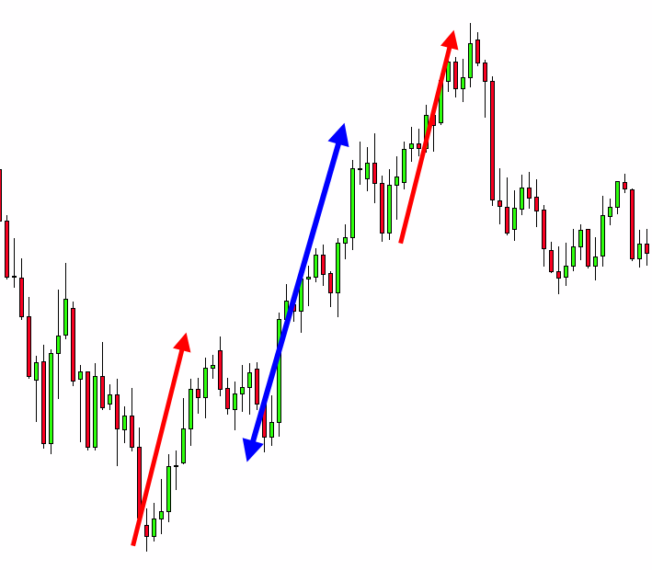

Slide 50
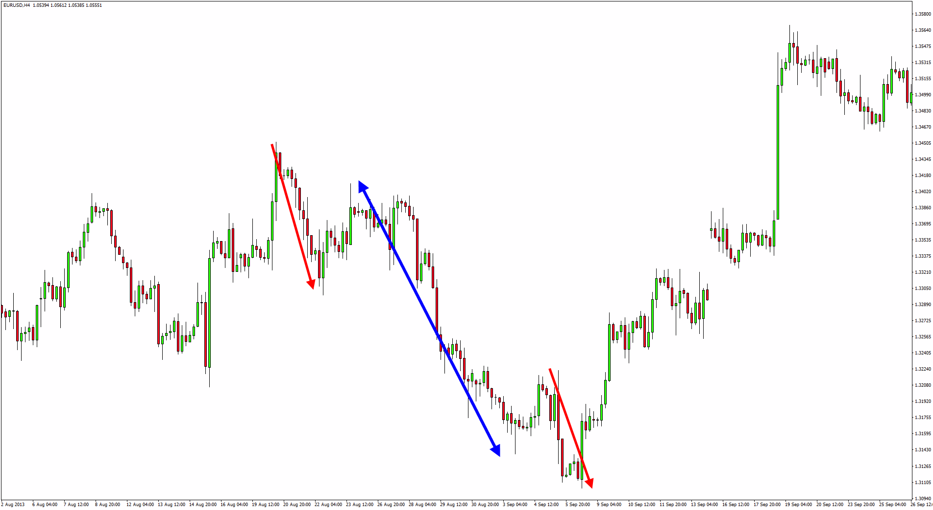

Slide 51
Range Cycle
Range comes after a trend move or end of cycle – ONLY!
Range is usually preceeded by 2 false breaks

Slide 52
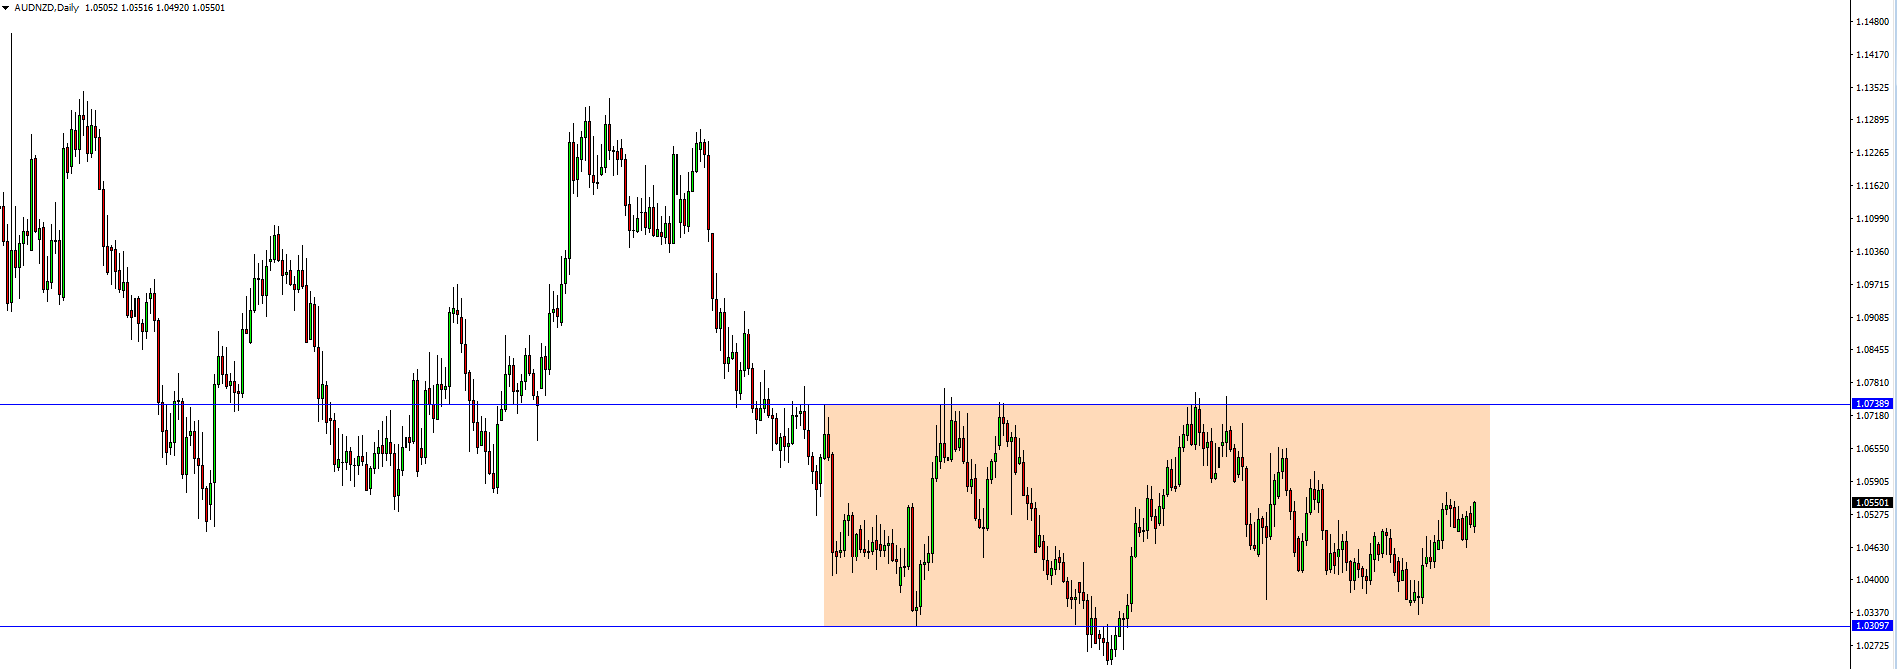

Slide 53
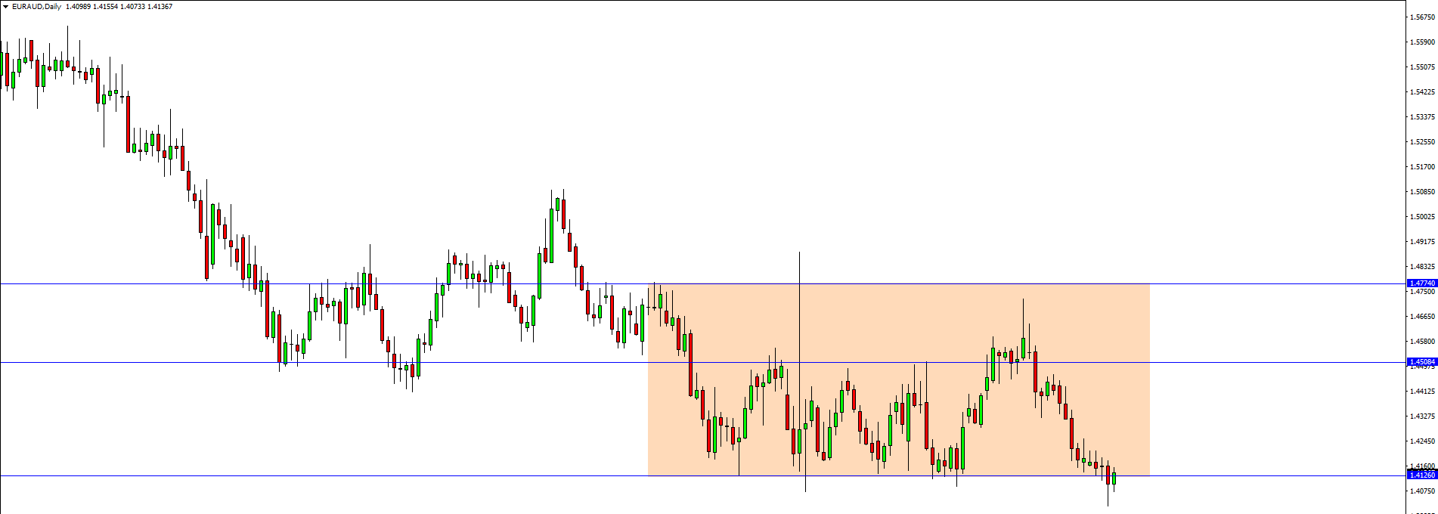

Slide 54
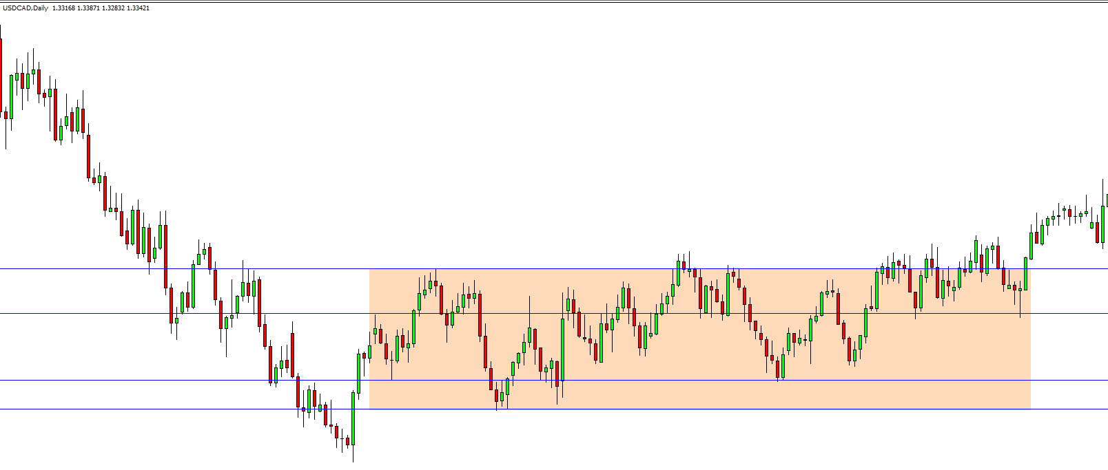
Example

Slide 55
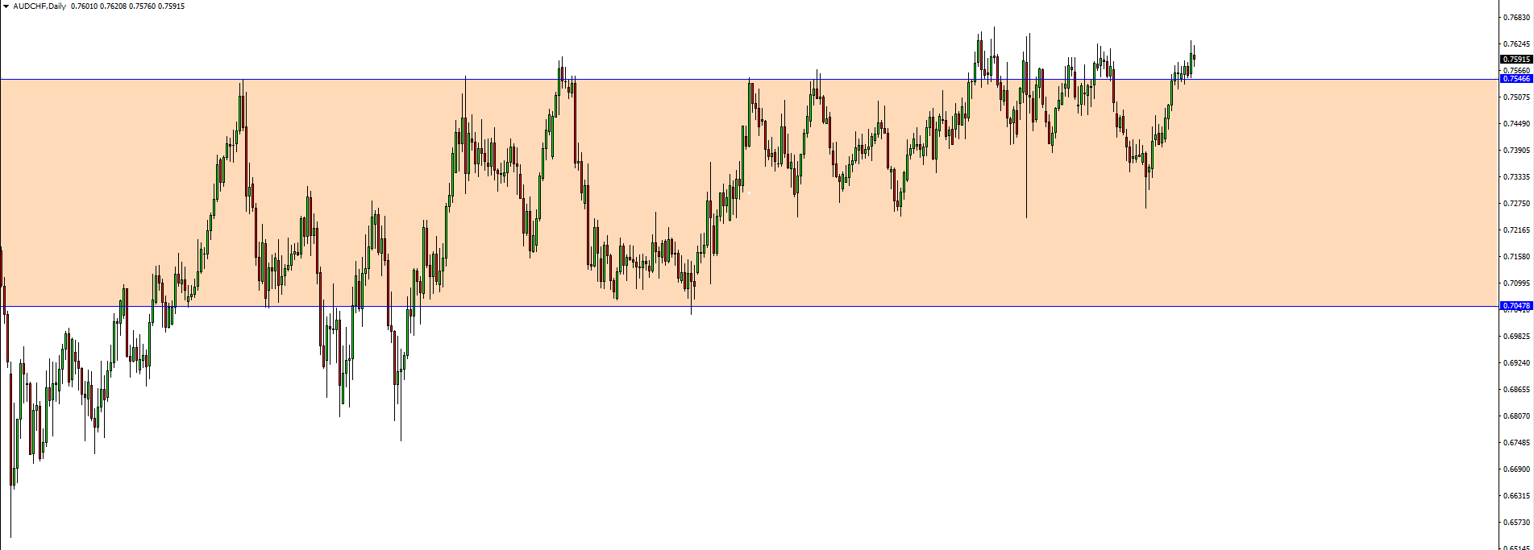
Example

Slide 56
Cycles Targets
To make this as simple as possible there are 2 targets that you need to remember:
Fibonacci Retracement 38,2%
Fibonacci Retracement 50%

Slide 57
Cycles Targets
Double Cycle – 38,2% of the whole move.
Triple Cycle – 50% of the whole move.
Special Cycle – 50% of the whole move.
Range Cycle – Opposite side of the range

Slide 58
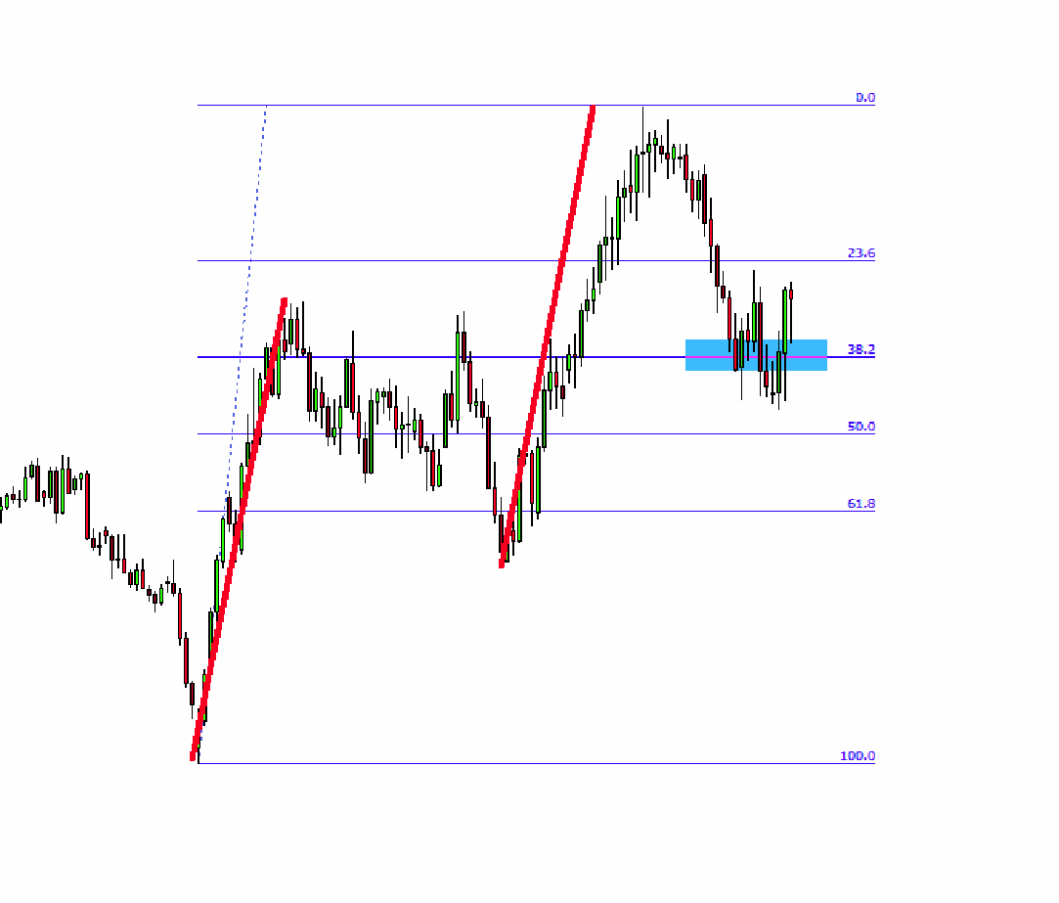
Double Bullish Cycle
Target 38,2%

Slide 59
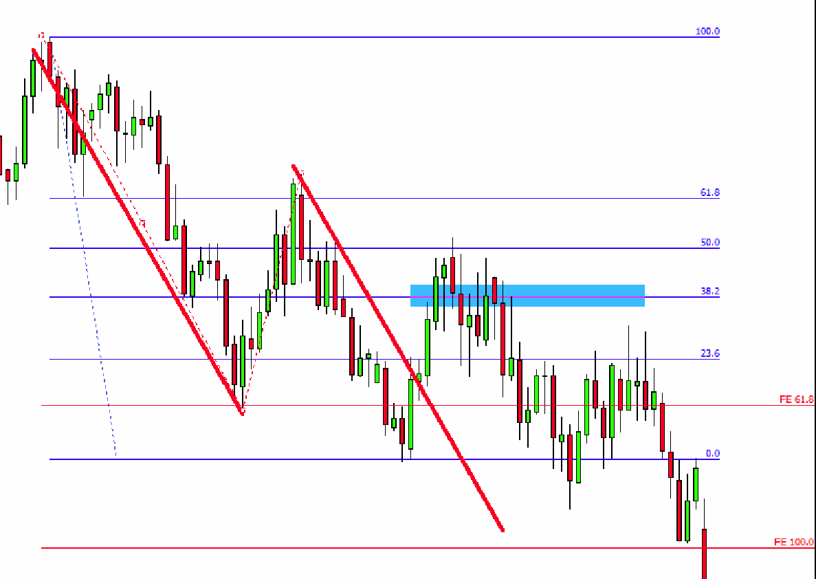
Double Bearish Cycle
Target 38,2%

Slide 60
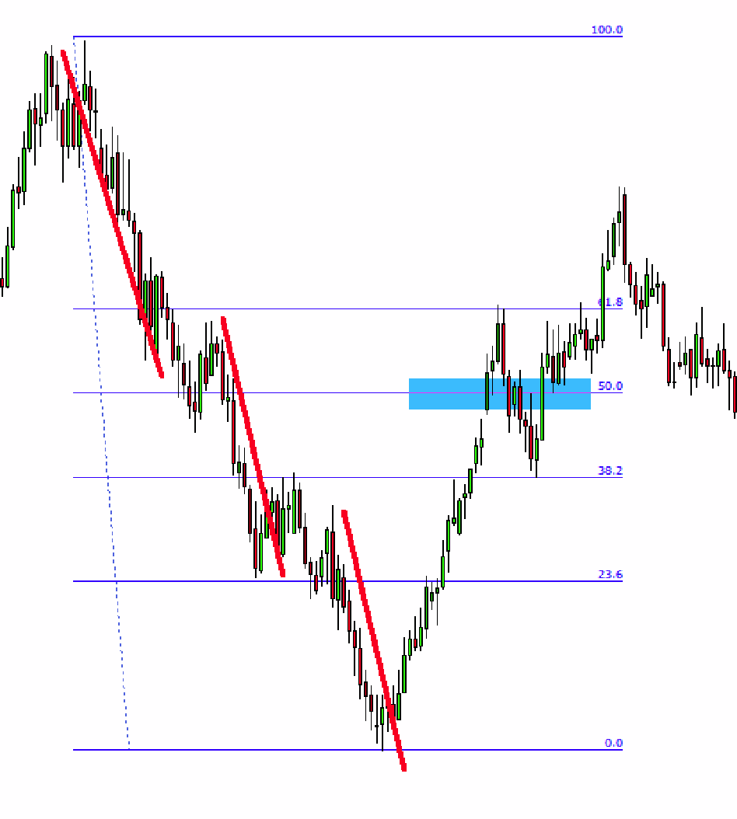
Triple Bearish Cycle
Target 50%

Slide 61
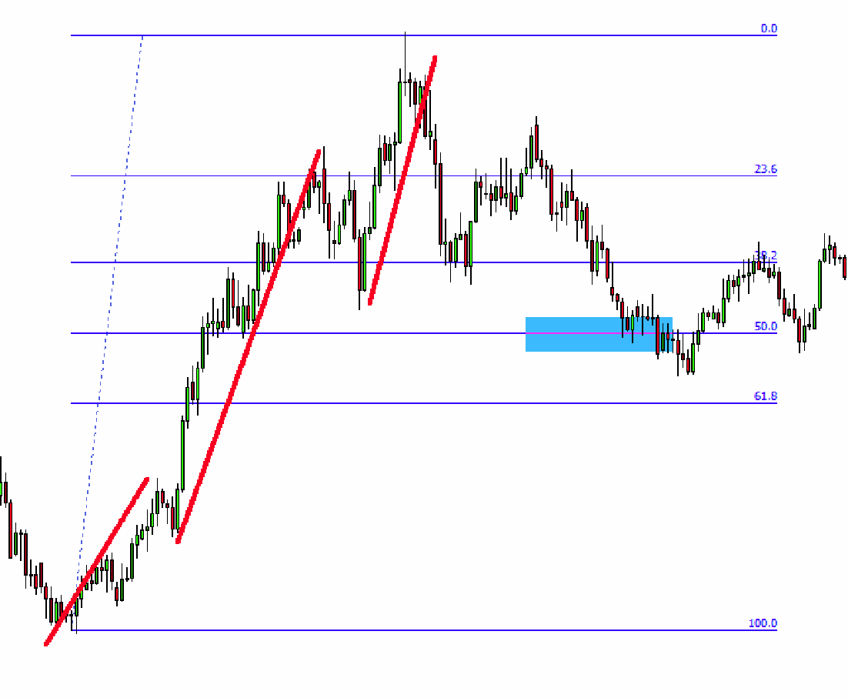
Special Bullish Cycle
Target 50%

Slide 62
Basics of Divergence
Before we move on, I will shortly introduce you to Divergences as they go hand in hand with Cycles.

Slide 63
What is Divergence?
When the price and the indicator (usually an Oscillator such as MACD, RSI, Stochastic) move in the opposite direction.
For example: Price is making higher highs, while indicator is making lower highs.

Slide 65
Important: Divergence
Divergences are more reliable on the higher time frames
Hidden divergence should always be confirmed on
Divergence should come after a real move (not zigzag)

Slide 66
Types Of Divergence
The Basic type of divergence could be sub-divided into 2 categories:
Regular (NPN/PNP)
Continuing

Slide 67
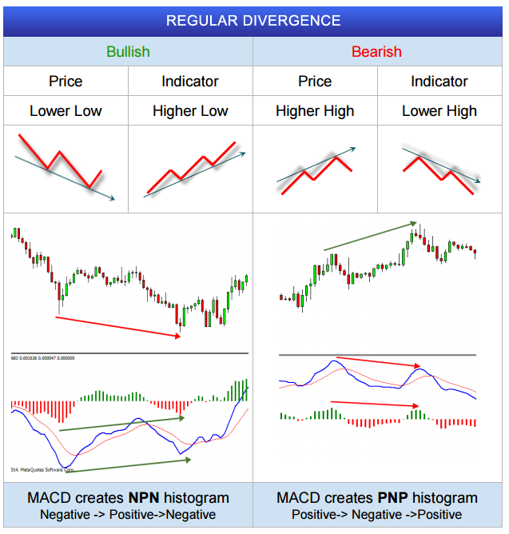
Regular

Slide 68
Continuing

Slide 69
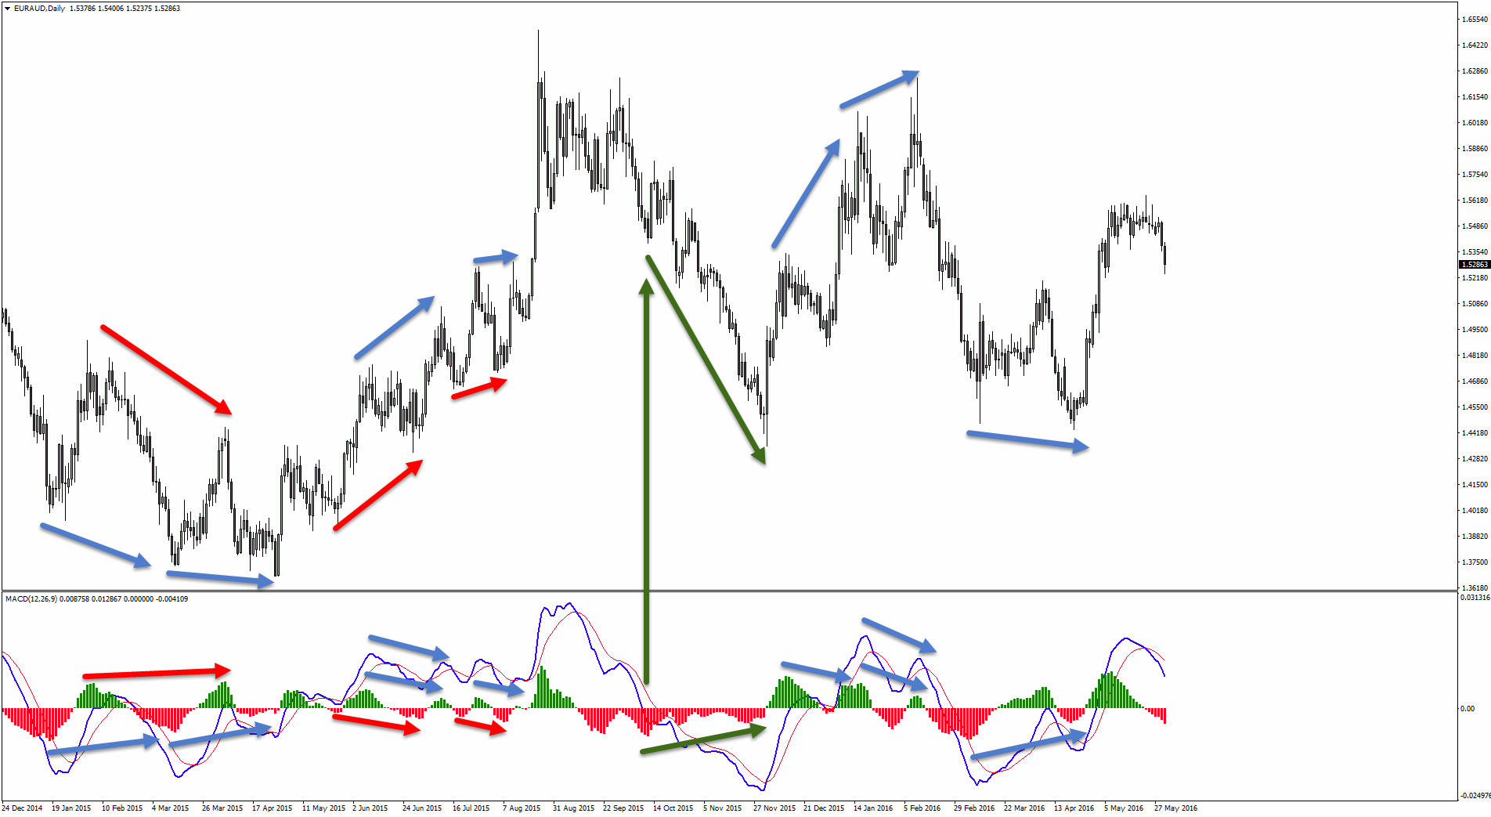

Slide 70
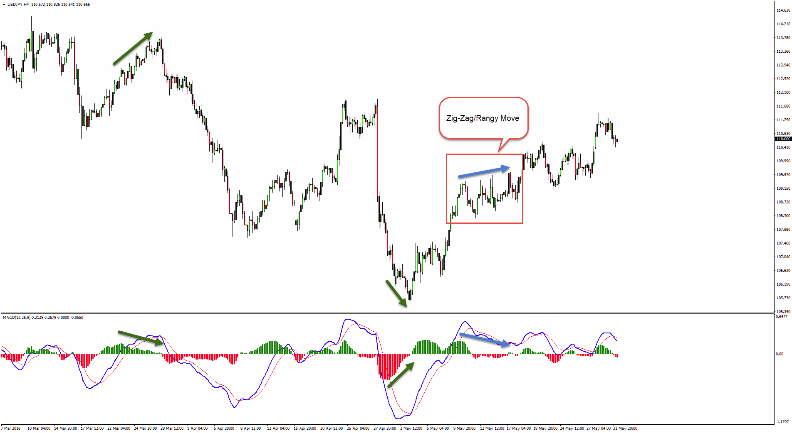

Slide 71
Statistics & Cycles
Trading is a “game” of Statistics and odds. The better odds
you have the more money you will make.
So the logical question arises: How do I improve my odds?
Once I defined my “problem” I was set to find a solution. I already had the Cycles method but that was only giving me one confirmation – one point of view. I knew I could improve my trading further!

Slide 72
Statistics & Cycles
In order to find the best answer to the question above I had
to consider one of the most common issues in trading and
analyzing: SUBJECTIVITY.
This is why i decided to remove it from the equation, at least
in this step of the decision making process.
That’s how I came up with the idea of the Statistical indicator!

Slide 73
Statistics & Cycles
1. I wanted a tool that will tell me what periods are Statistically reliable for the price to create a Bottom or Top.
2. I needed a method to identify price reversals based on TIME rather than price, as Cycles already did pretty good job identifying reversals based on price (X and Y – price and time)
3. I needed this indicator to be 100% Objective so I don’t have to worry whether i’m reading it correct or not.

Slide 74
Statistics & Cycles
4. I needed this indicator to be extremely easy to use.
5. To NOT use a lot of CPU/RAM so I can use it on any computer or laptop.
6. To give me accurate readings on ANY financial instruments that I would like to trade without the need to adjust settings every time.

Slide 75
Statistics & Cycles
Was I asking for TOO much ???
My programmers said I was…
But even they said it’s one of BEST tools they worked on.

Slide 76
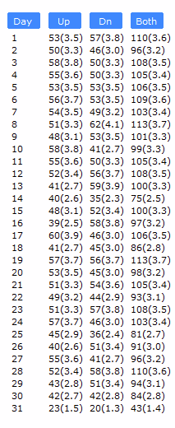
Statistics & Cycles
This is basically the short story of how the Statistical Indicator was born.
It is the lightest piece of software you will ever use, completely adjustable, with clean design but most of all – USEFUL and ACCURATE, especially in combination with the Cycles method.

Slide 77
Statistics & Cycles
So what i started doing was:
Find a horizontal reversal point (X axis) based on Cycles.
Find a vertical reversal point (Y axis) based on Time.
This way I would end up with kind of a Rectangle where I knew price will most likely reverse.

Slide 78
Statistics & Cycles
Definition:
Identify reliable reversal dates on your chart – be that may Tops or Bottoms. In essenace the indicator represent vertical support and resistance ranges which the trader might use as an extra confirmation to other factors and variables in the decision making process.

Slide 79
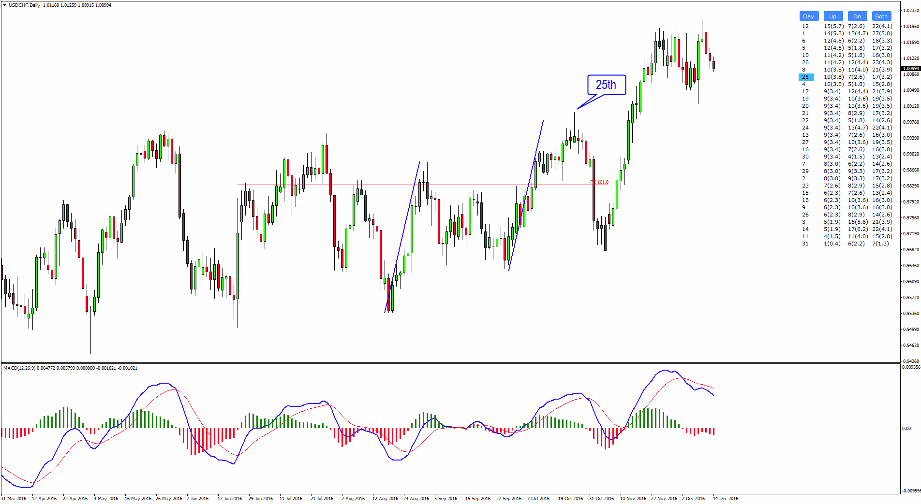
D1 Cycle + Statistics

Slide 80
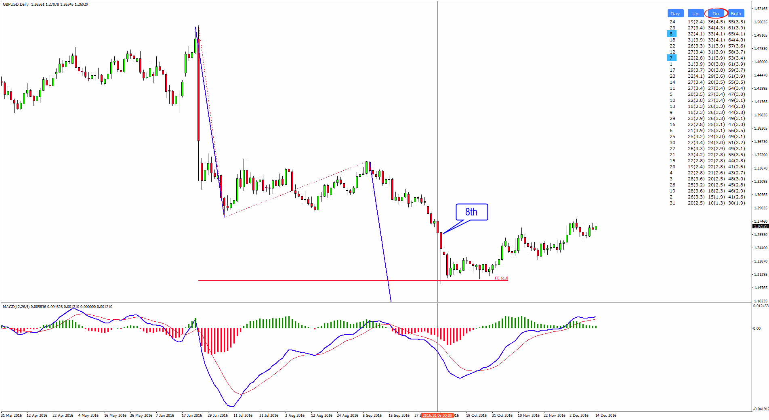
D1 Cycle + Statistics

Slide 81
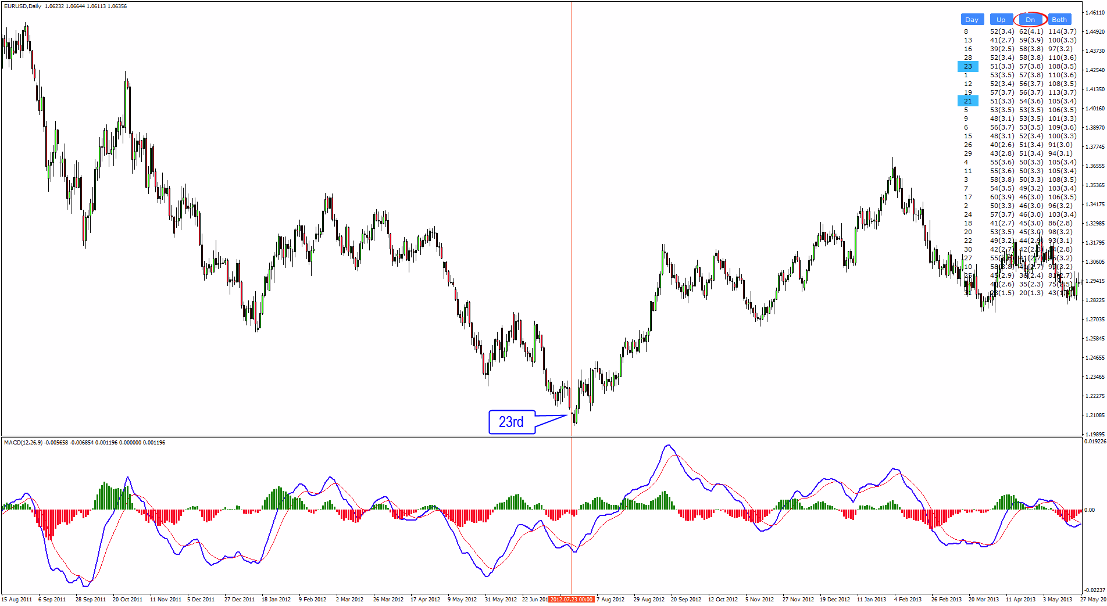
(D1 Cycle) + Statistics

Slide 82
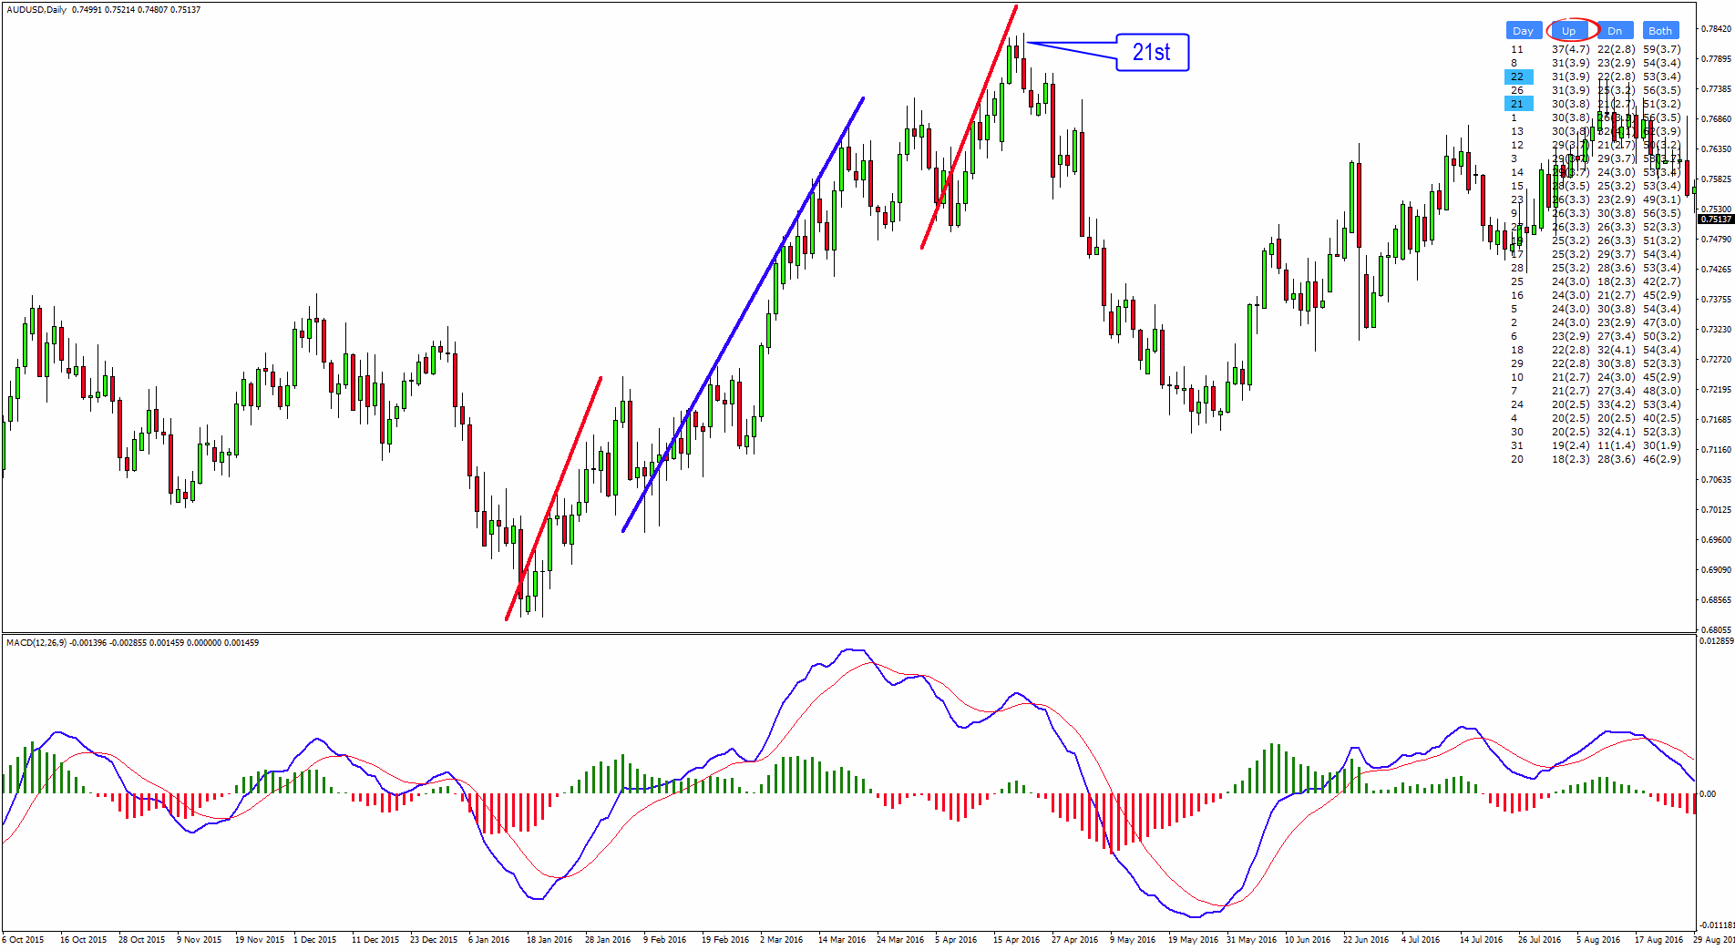
D1 Cycle + Statistics

Slide 83
How the powerful combination of Cycles + Statistics can provide amazing RISK:REWARD ratio trade?

Slide 84
Risk:Reward Trading
I’m sure I got your attention already but trust me, best part is yet to be revealed.
Knowing that we can expect a reversal zone within a specific Horizontal and Vertical ranges is pretty much half of the work.
At this point we just need to WAIT FOR CONFIRMATION
and figure out a way to enter (apply trading strategy).

Slide 85
Risk:Reward Trading
The greatest thing about Cycles is that at this point – when you know the direction - you may apply
ANY TRADING METHOD/STRATEGY/SYSTEM
that you have in your arsenal.

Slide 86
Risk:Reward Trading
How do we do that?
We are going to look for entries 1 or 2 time frames lower.
So if you spot a Cycle that is confirmed by Statistics on the D1 chart for example, you will be looking for entries on the H4 or H1 charts.
Let’s see a few examples:

Slide 87
D1 Special Bullish Cycle AUDUSD R:R Ratio – 1 : 7.5

Slide 88
D1 Cycle + Statistics

Slide 89
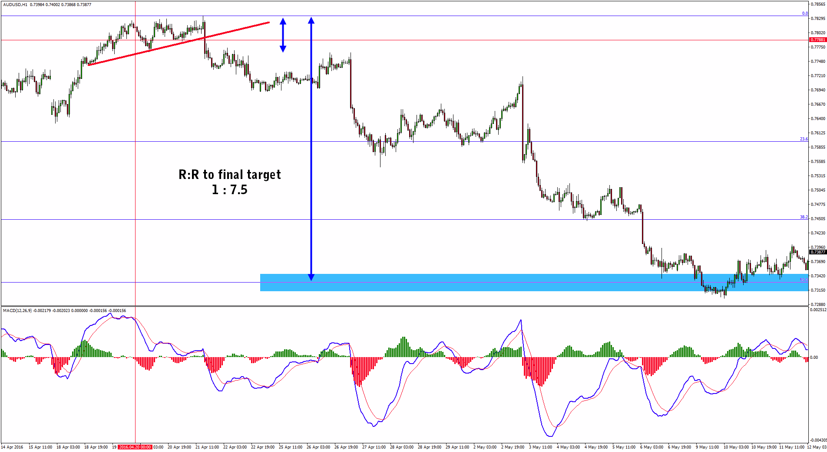

Slide 90
D1 Triple Bearish Cycle EURUSD R:R Ratio – 1 : 21

Slide 91
(D1 Cycle) + Statistics

Slide 92
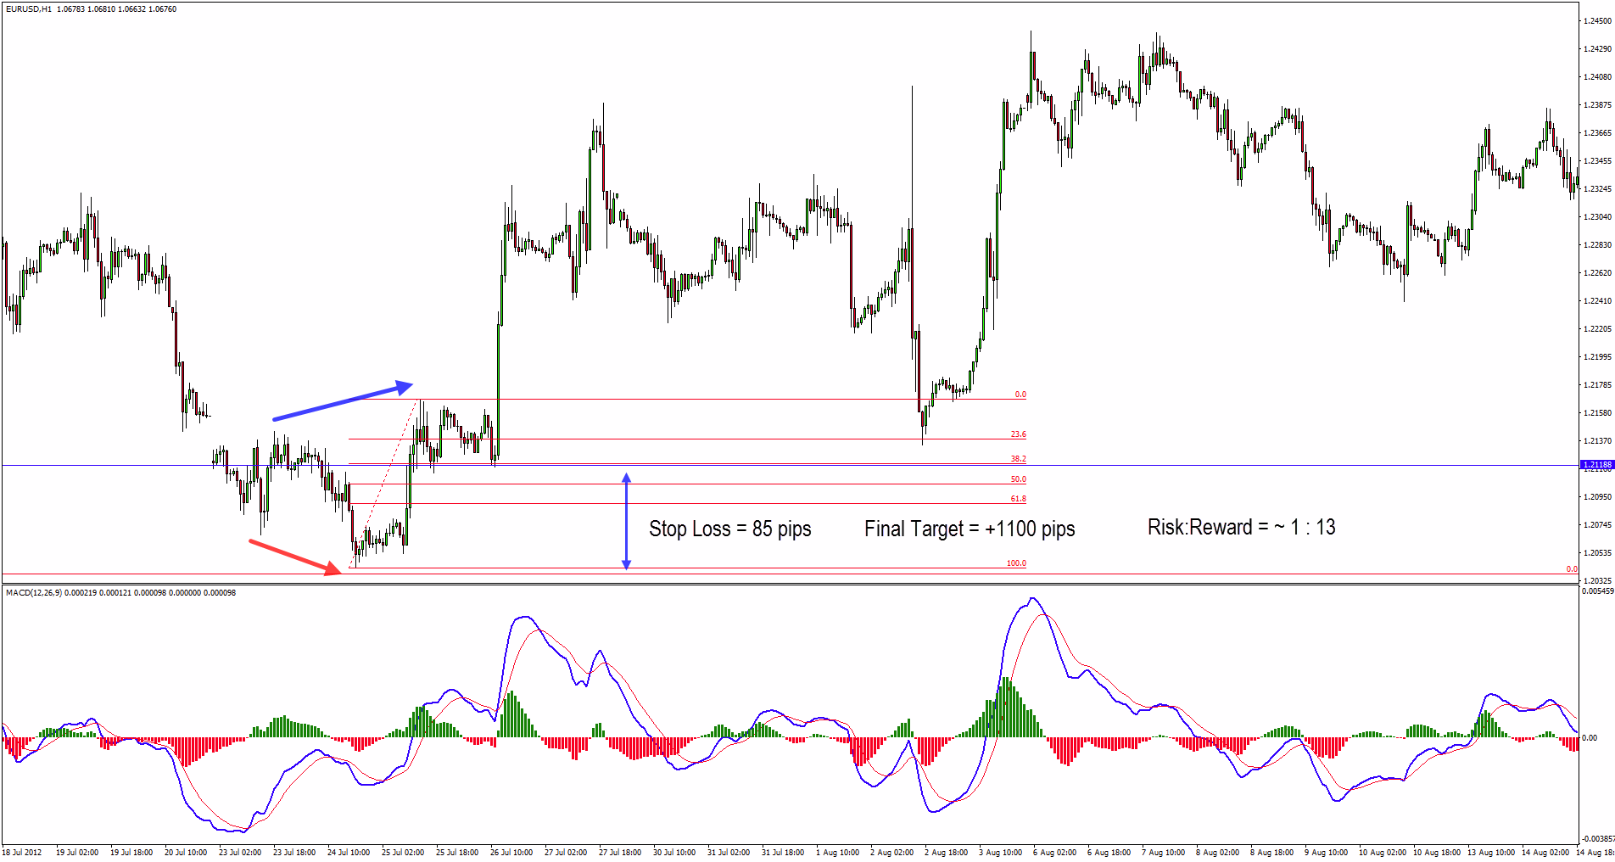

Slide 93
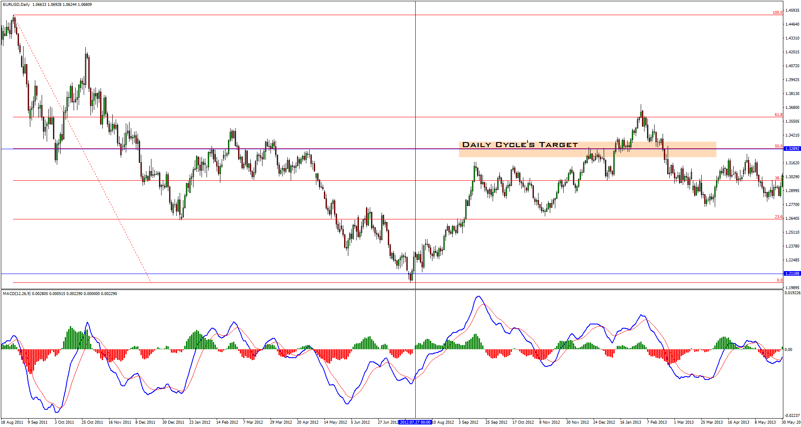

Slide 94
D1 Double Bullish Cycle GBPAUD R:R Ratio – 1 : 5

Slide 95
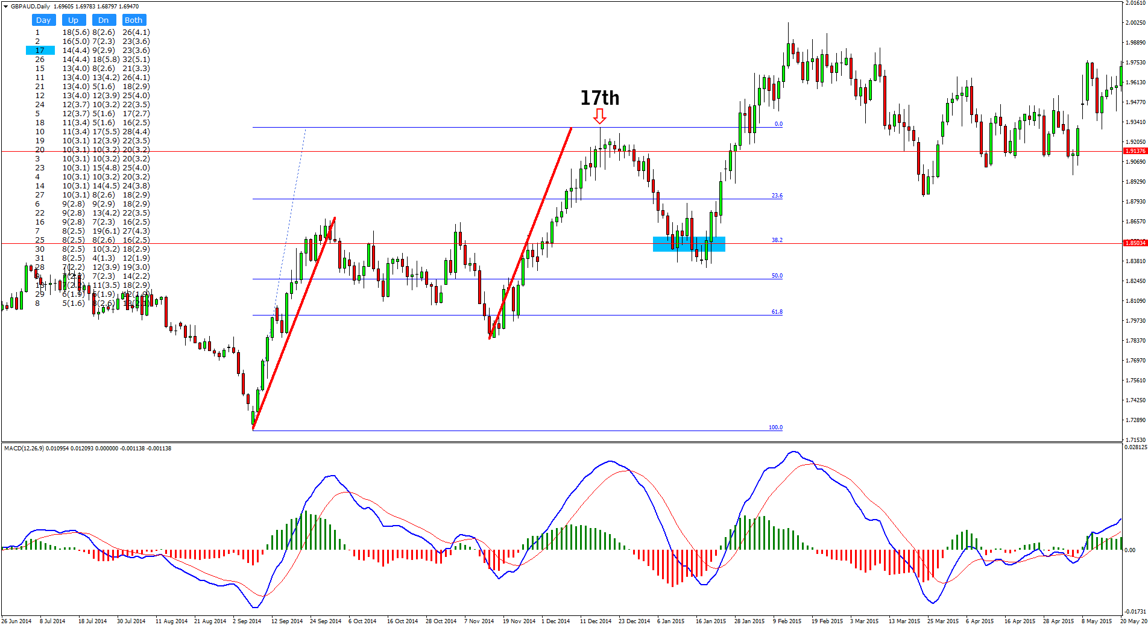

Slide 96
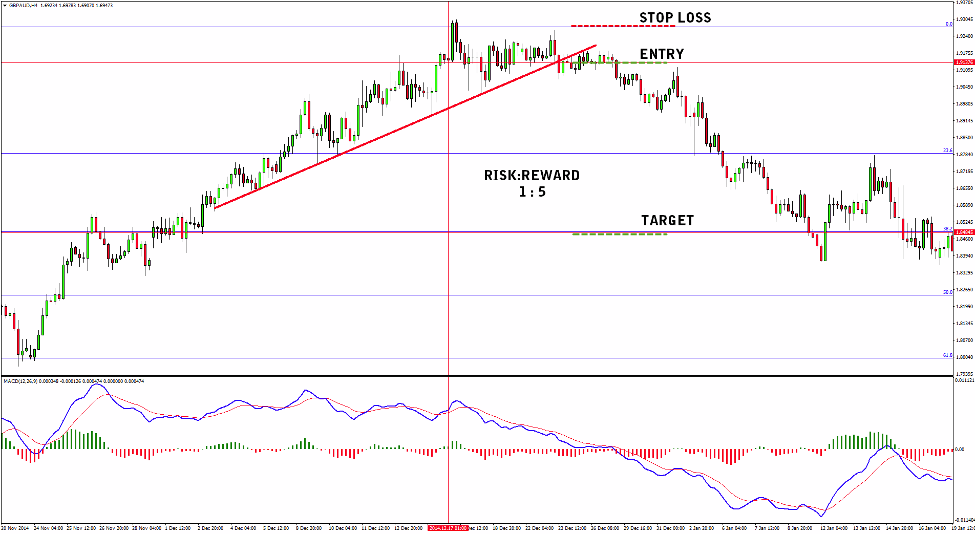

Slide 97
D1 Triple Bearish Cycle GBPAUD R:R Ratio – 1 : 10

Slide 98
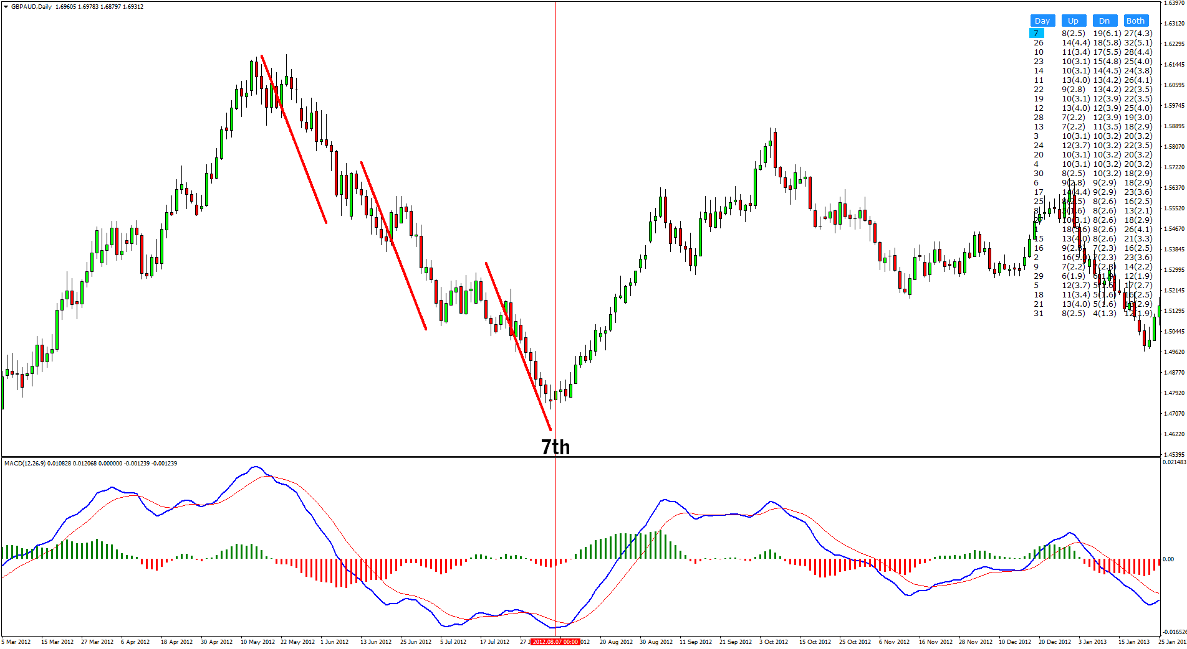

Slide 99
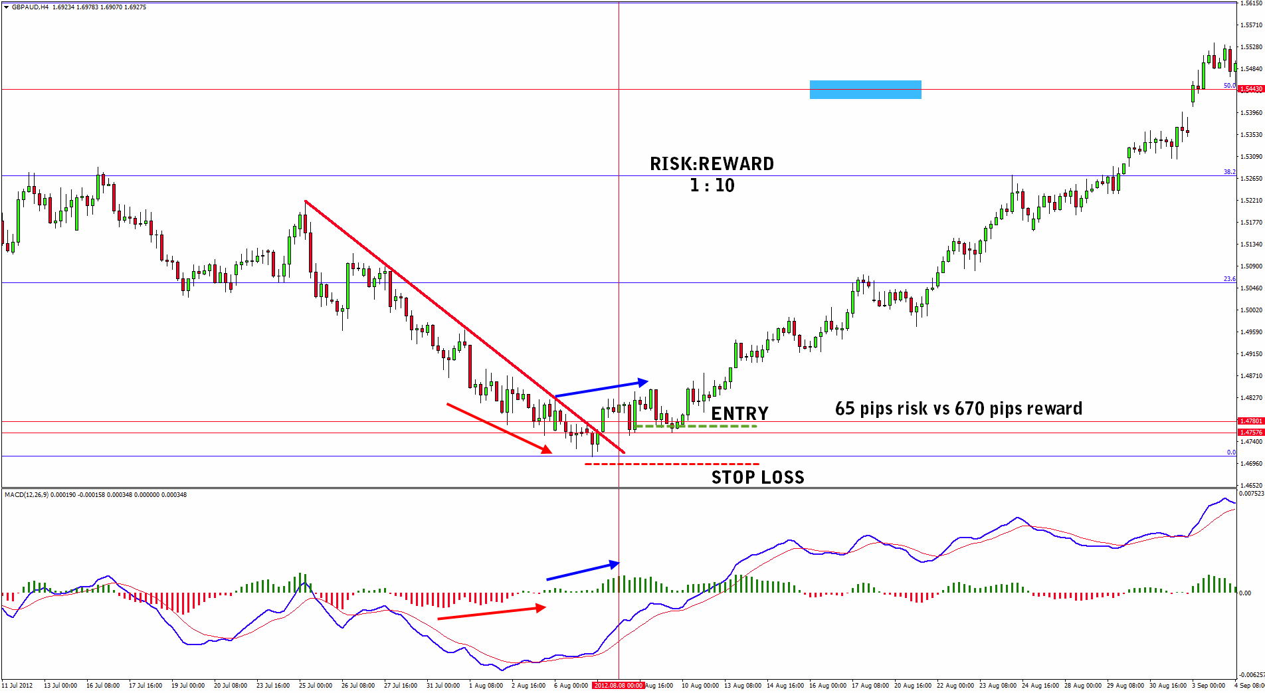

Slide 100
Mirror Principle
MAIN PURPOSE:
It gives us specific time range within which our target should be reached.
If the target is not reached by the “deadline” we get out
of the trade (assuming that the SL is not reached as well).

Slide 101
Mirror Principle
HOW TO MEASURE IT:
Count the number of candles that it took for the cycle to develop from the lowest to the highest point or vice versa:
Let’s use the examples from before so you keep
track of the whole process.

Slide 103
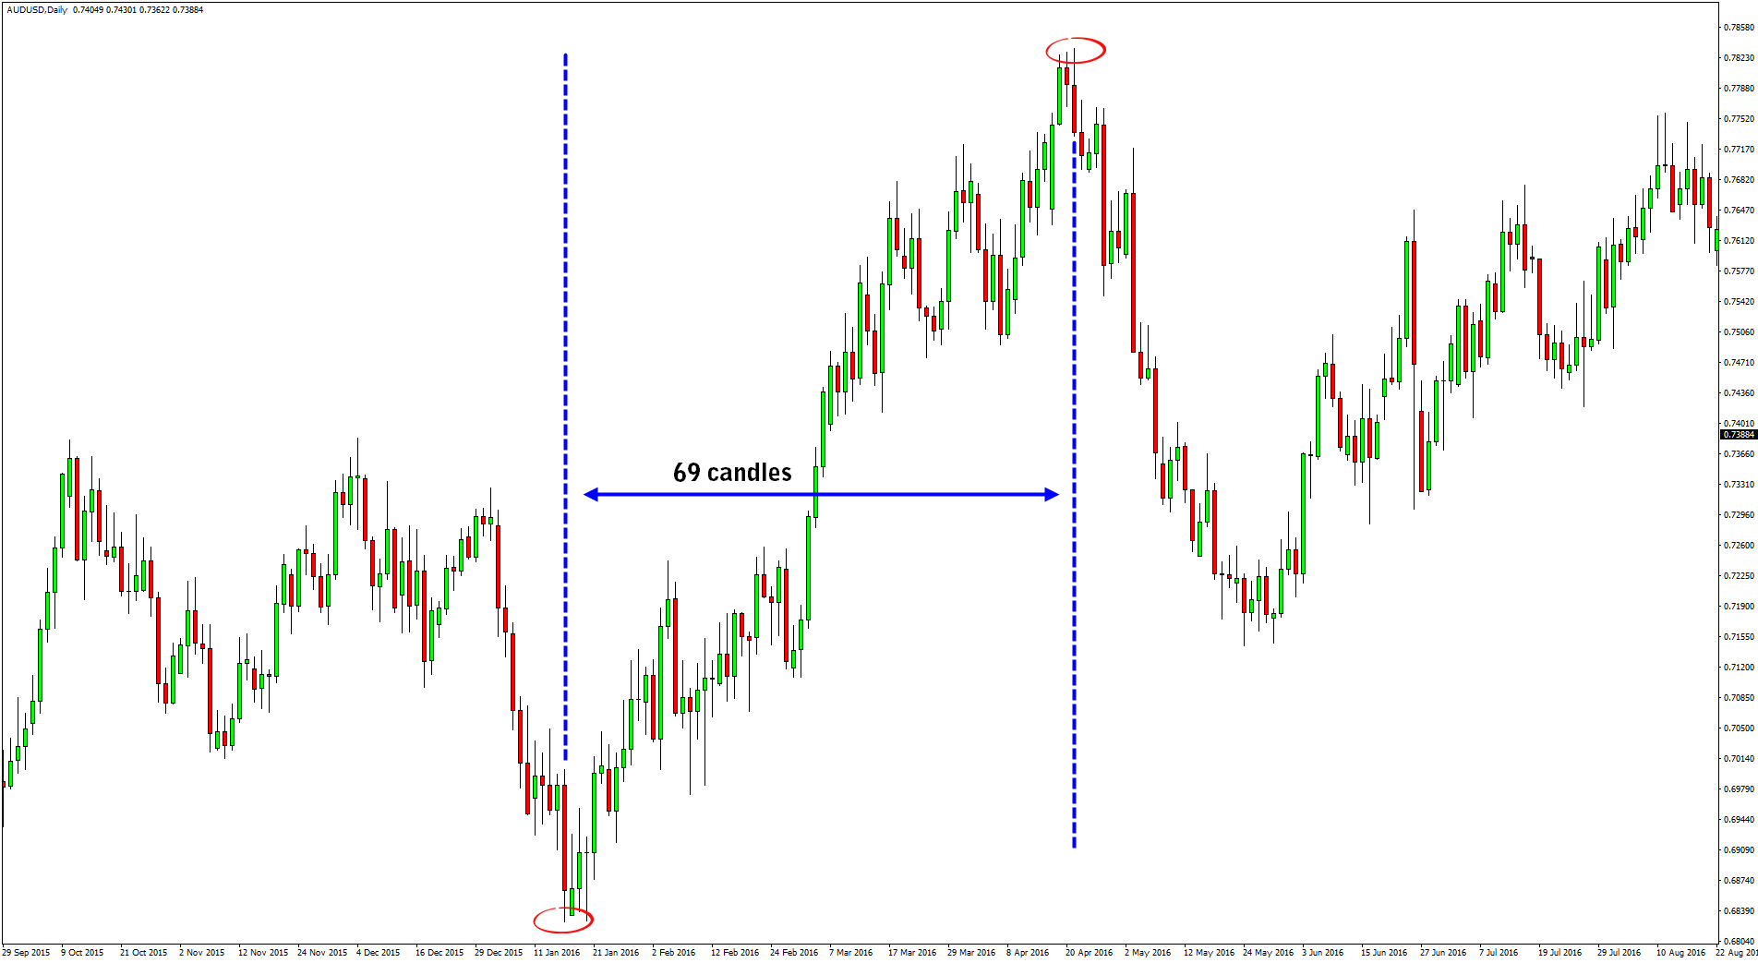

Slide 104
Mirror Principle
HOW TO MEASURE IT:
2. Now we count same number of candles (same period) starting from the ending point of the cycle. This excercise will give us a specific time in the future.
This specific time is our “deadline”. If price doesn’t reach
the target (or stop) by this mark up, we close the trade manually.

Slide 105
Mirror Principle
That’s all! Now let’s check out more examples:

Slide 106
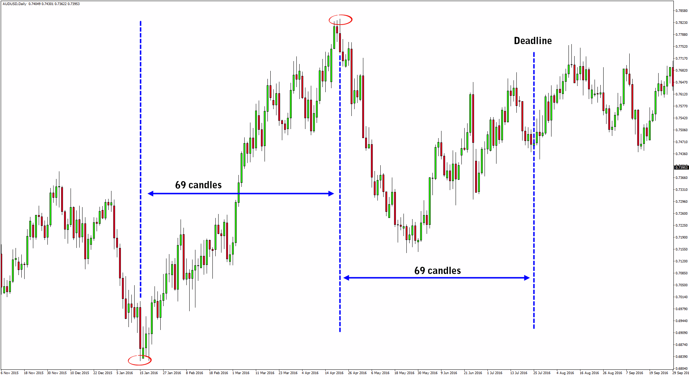

Slide 107
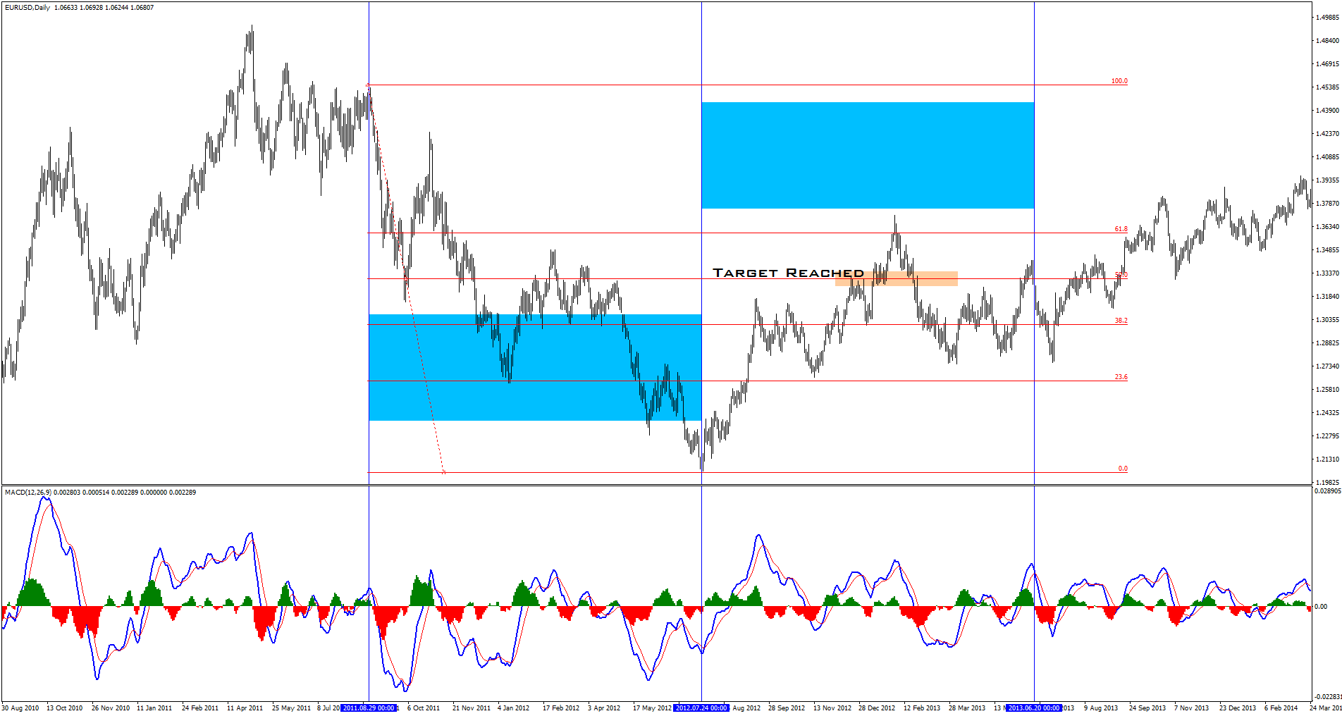

Slide 111
Thank you for your time!
www.VladimirRibakov.com

